Slide 1
OPPARI
Oppari//Alisa Rissanen & Harri Kurki

Slide 2
What is Oppari
A premise for independent studying and a place to get IT quidance
Rooms for group working
Lobby for studying
IT service desk

Slide 3
Where?
Kuopio, Canthia 2nd floor
Joensuu, Carelia 1st floor
Opening hours in Kamu

Slide 4
What can you find in Oppari?
IT Service desk
Harri and Alisa + part timers
Staff from Digital Services
Windows computers – no need for reservations
Software for studies
Multifunctional printers
Printing, copying scanning
Rooms for group work – reservations max 3 hrs/day
Loan laptops

Slide 5
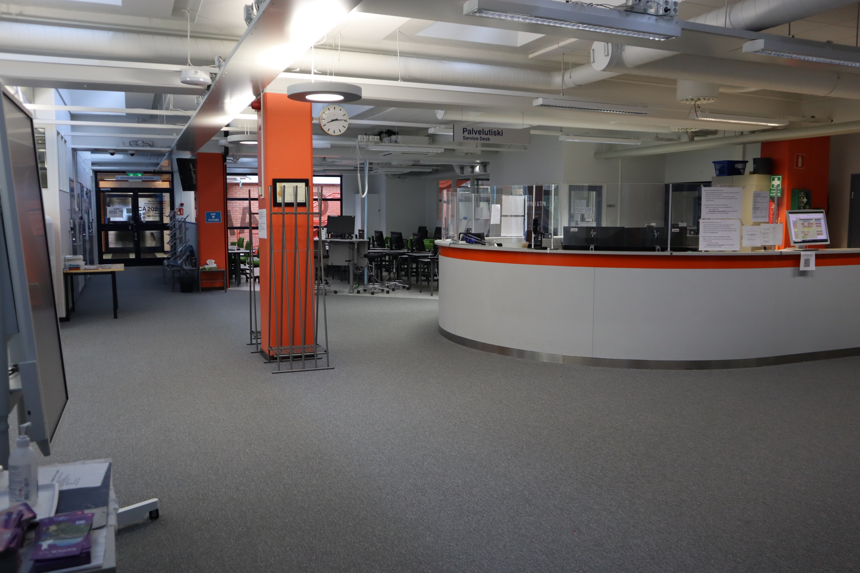
IT Service Desk
Installation guidance for UEF supported software
Support for IT issues
Service desk is not fixing personal computers
Printing support
Help with thesis
Accessibility
Final touches, e.g. page numbering
Book teamwork rooms
Lost and found

Slide 6
Printing — Money
Free printing credit 9€/semester
Will be set to 9€ on 16.9. and 16.1.
If you run out of printing credit => printing.uef.fi
Login with your UEF username and password and DO NOT use the @uef.fi suffix
Same credentials work with the printers as well

Slide 7
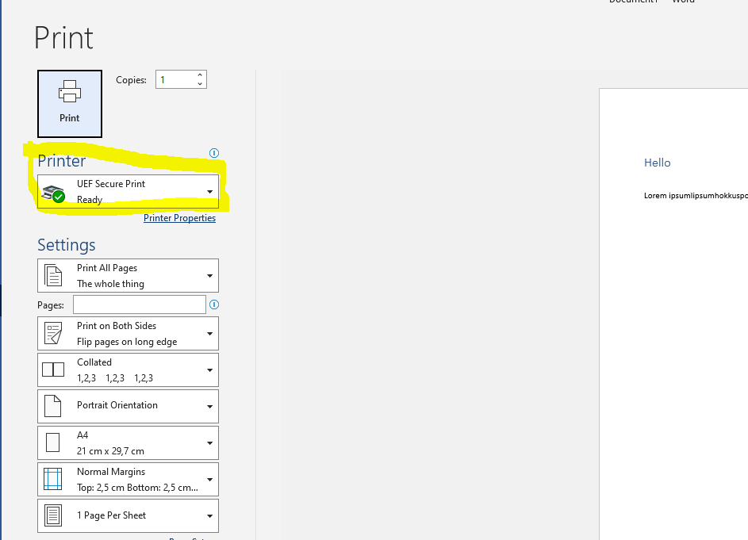
Printing — How? Where?
Using school computers
UEF Secure Print
Using UEF email
Send the document as an attachment to kmext-print@uef.fi
Fix the color settings after logging in to the printer

Slide 8
Contact
asiointi.uef.fi // eservices.uef.fi
Student Services => Student’s Digital Skills
Oppari
Canthia 2nd floor
Carelia 1st floor
Oppari - opening hours - UEF Kamu
During semesters, staff from Digital Services in Oppari 10-14, mon-fri

