Slide 1
LIFE OF INTERNATIONAL STUDENTS IN UEF (KUOPIO)
Mahim Afridi Musa
International Business And Sales Management

Slide 2
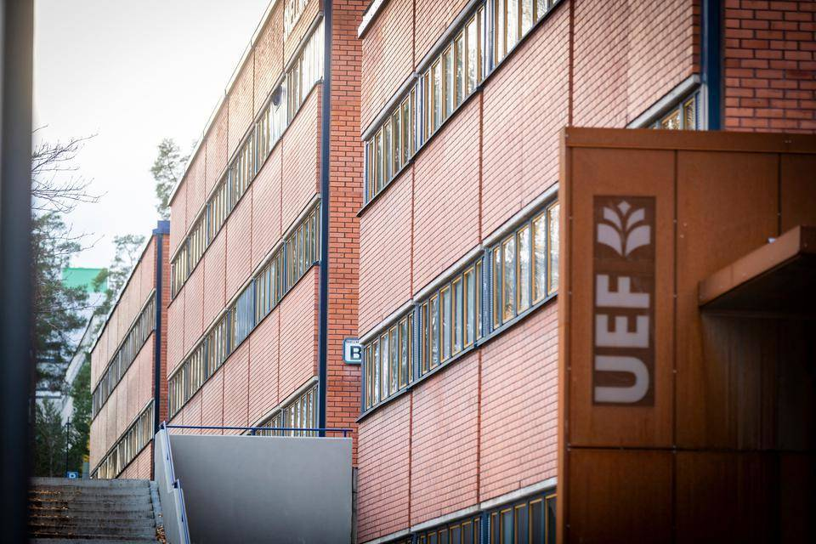

Life at UEF (Kuopio)
Routine Life
Everything Around The Corner
Big Library
Quite Spaces
Nice Canteen
Modern Technologies

Slide 3
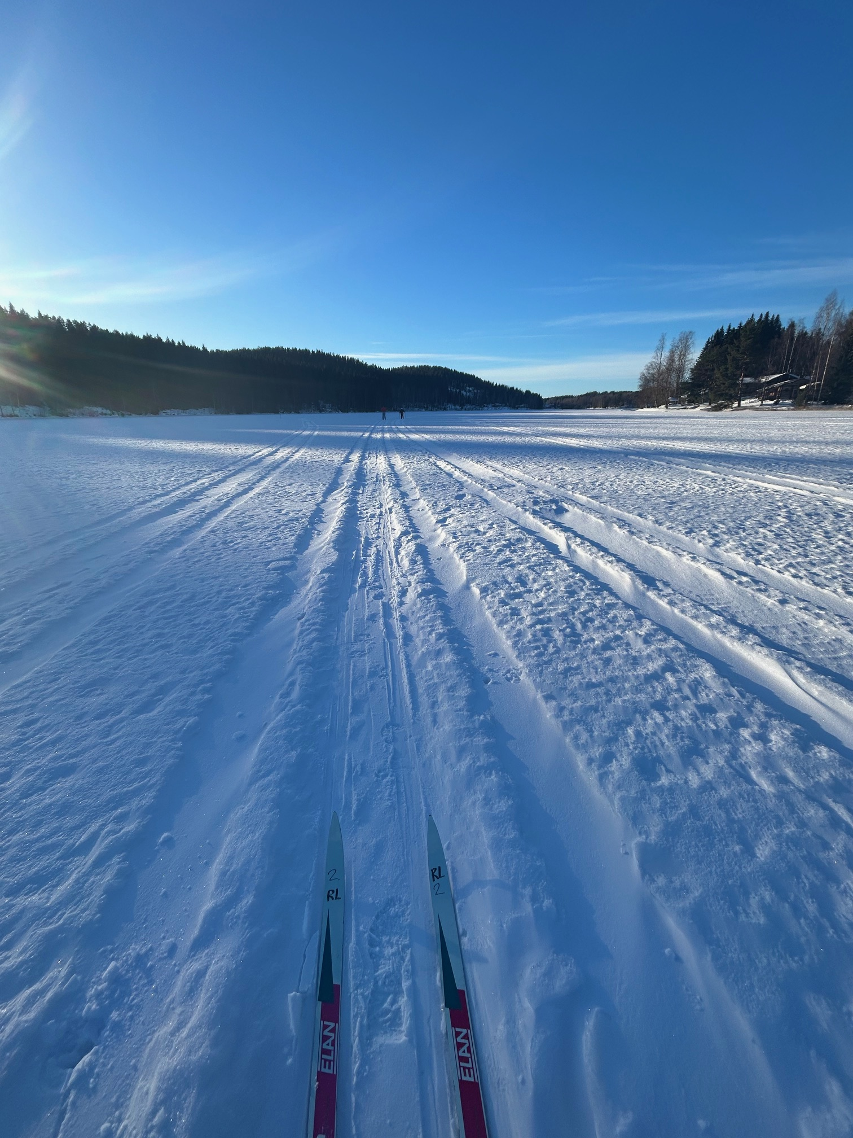
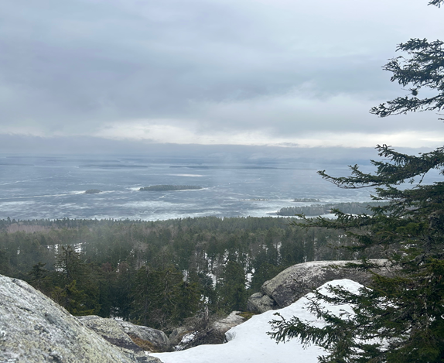
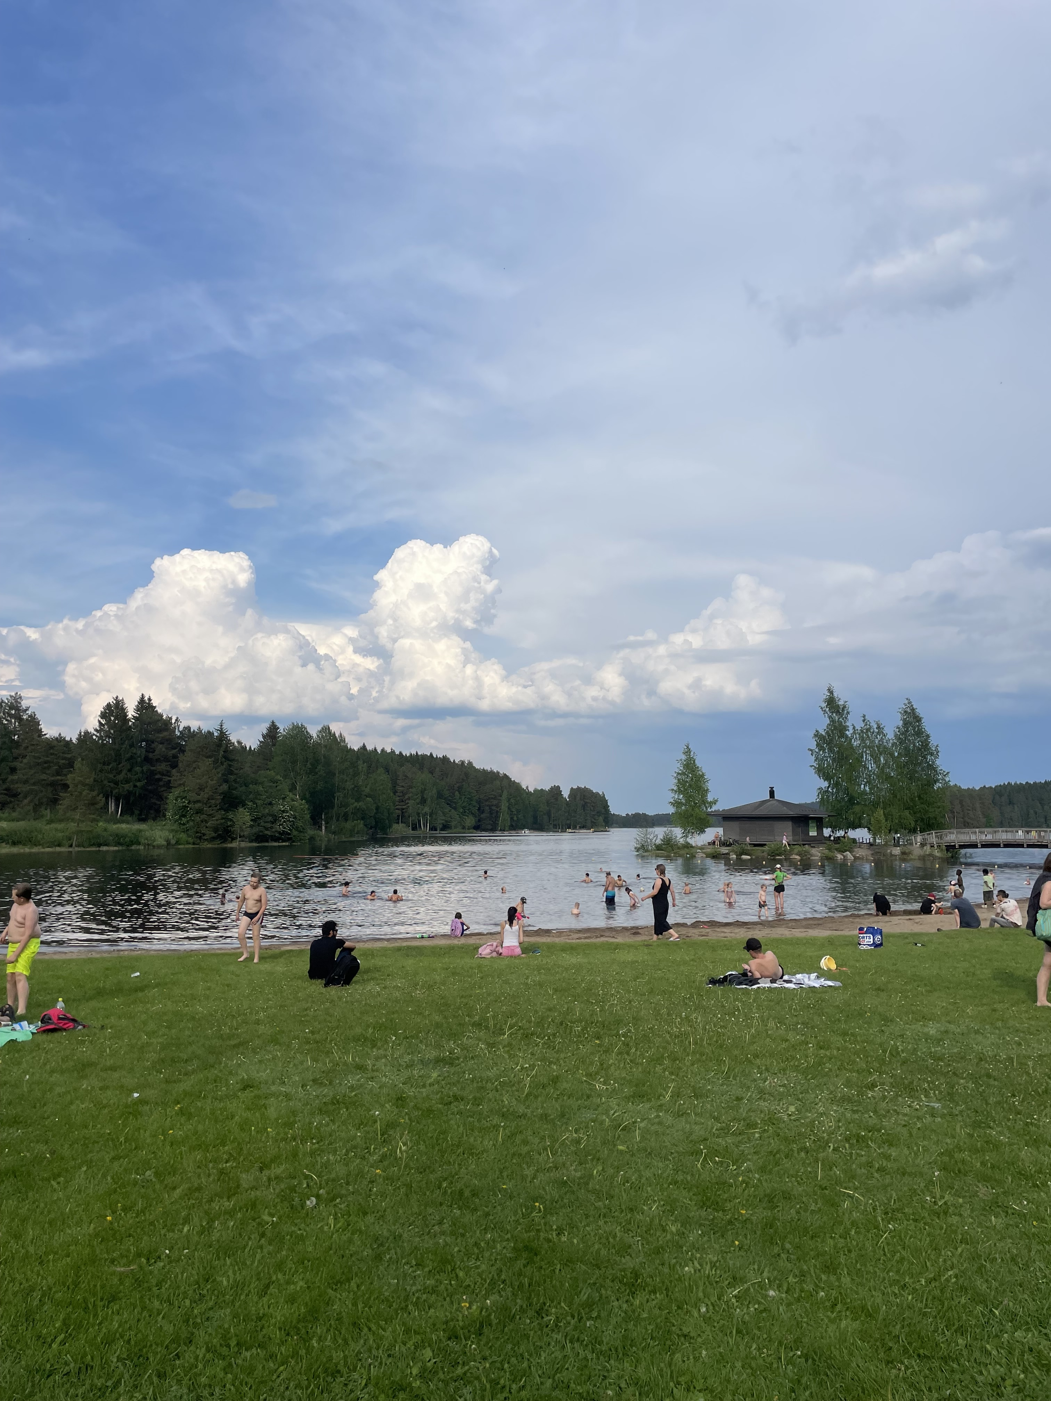
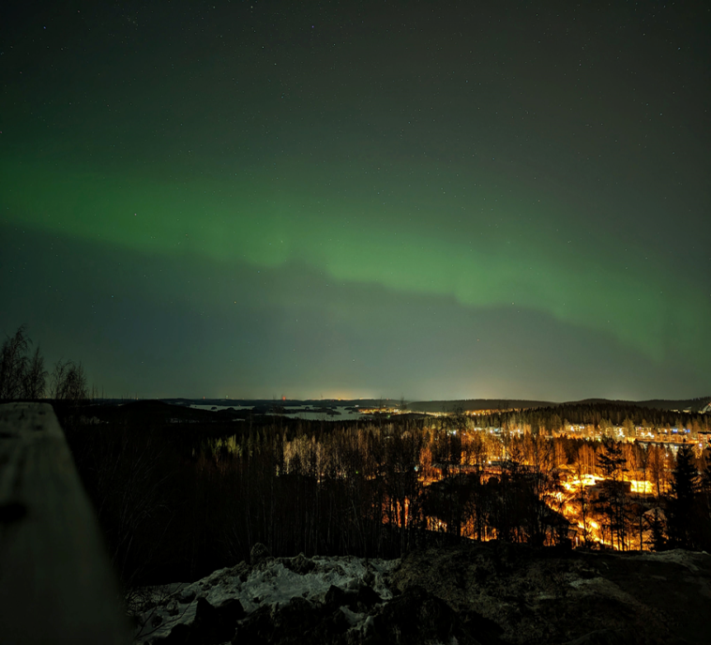
LIFE OUTSIDE THE UNIVERSITY
Being in the nature
Skiing, Ice Skating
Swimming
Aurora Hunt

Slide 4
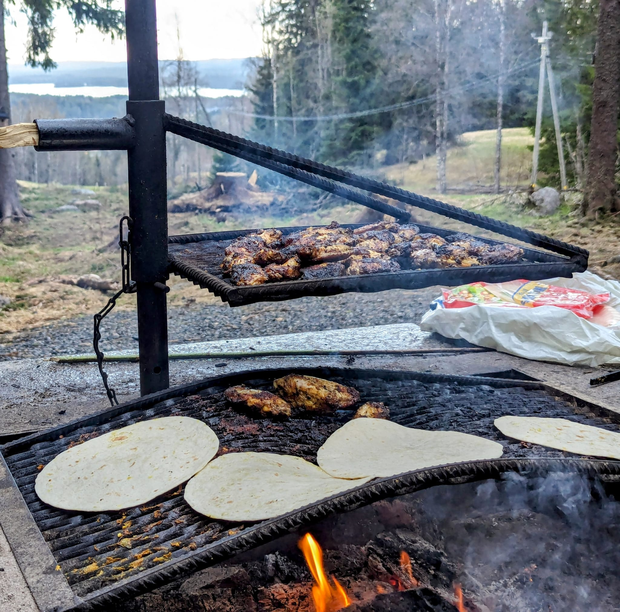

PARTIES AND NIGHTLIFE

Slide 5

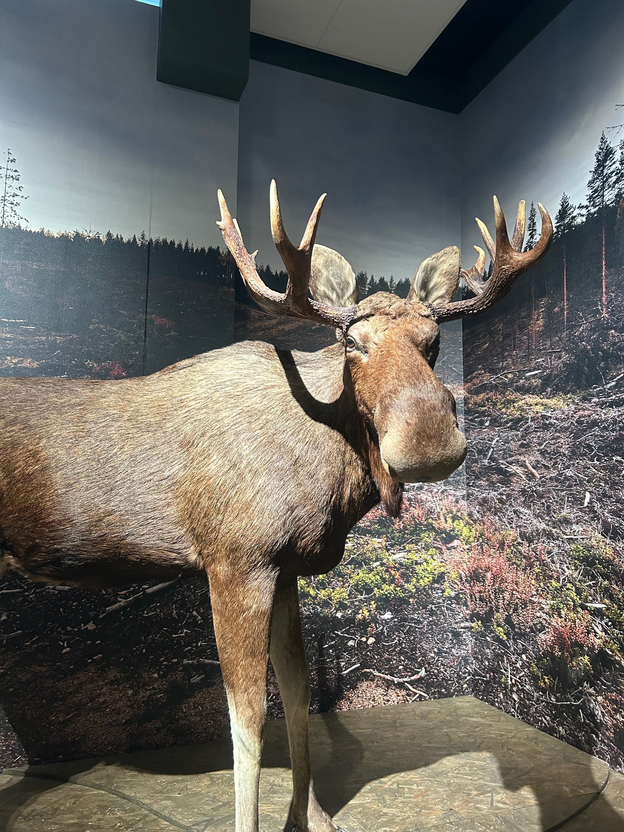
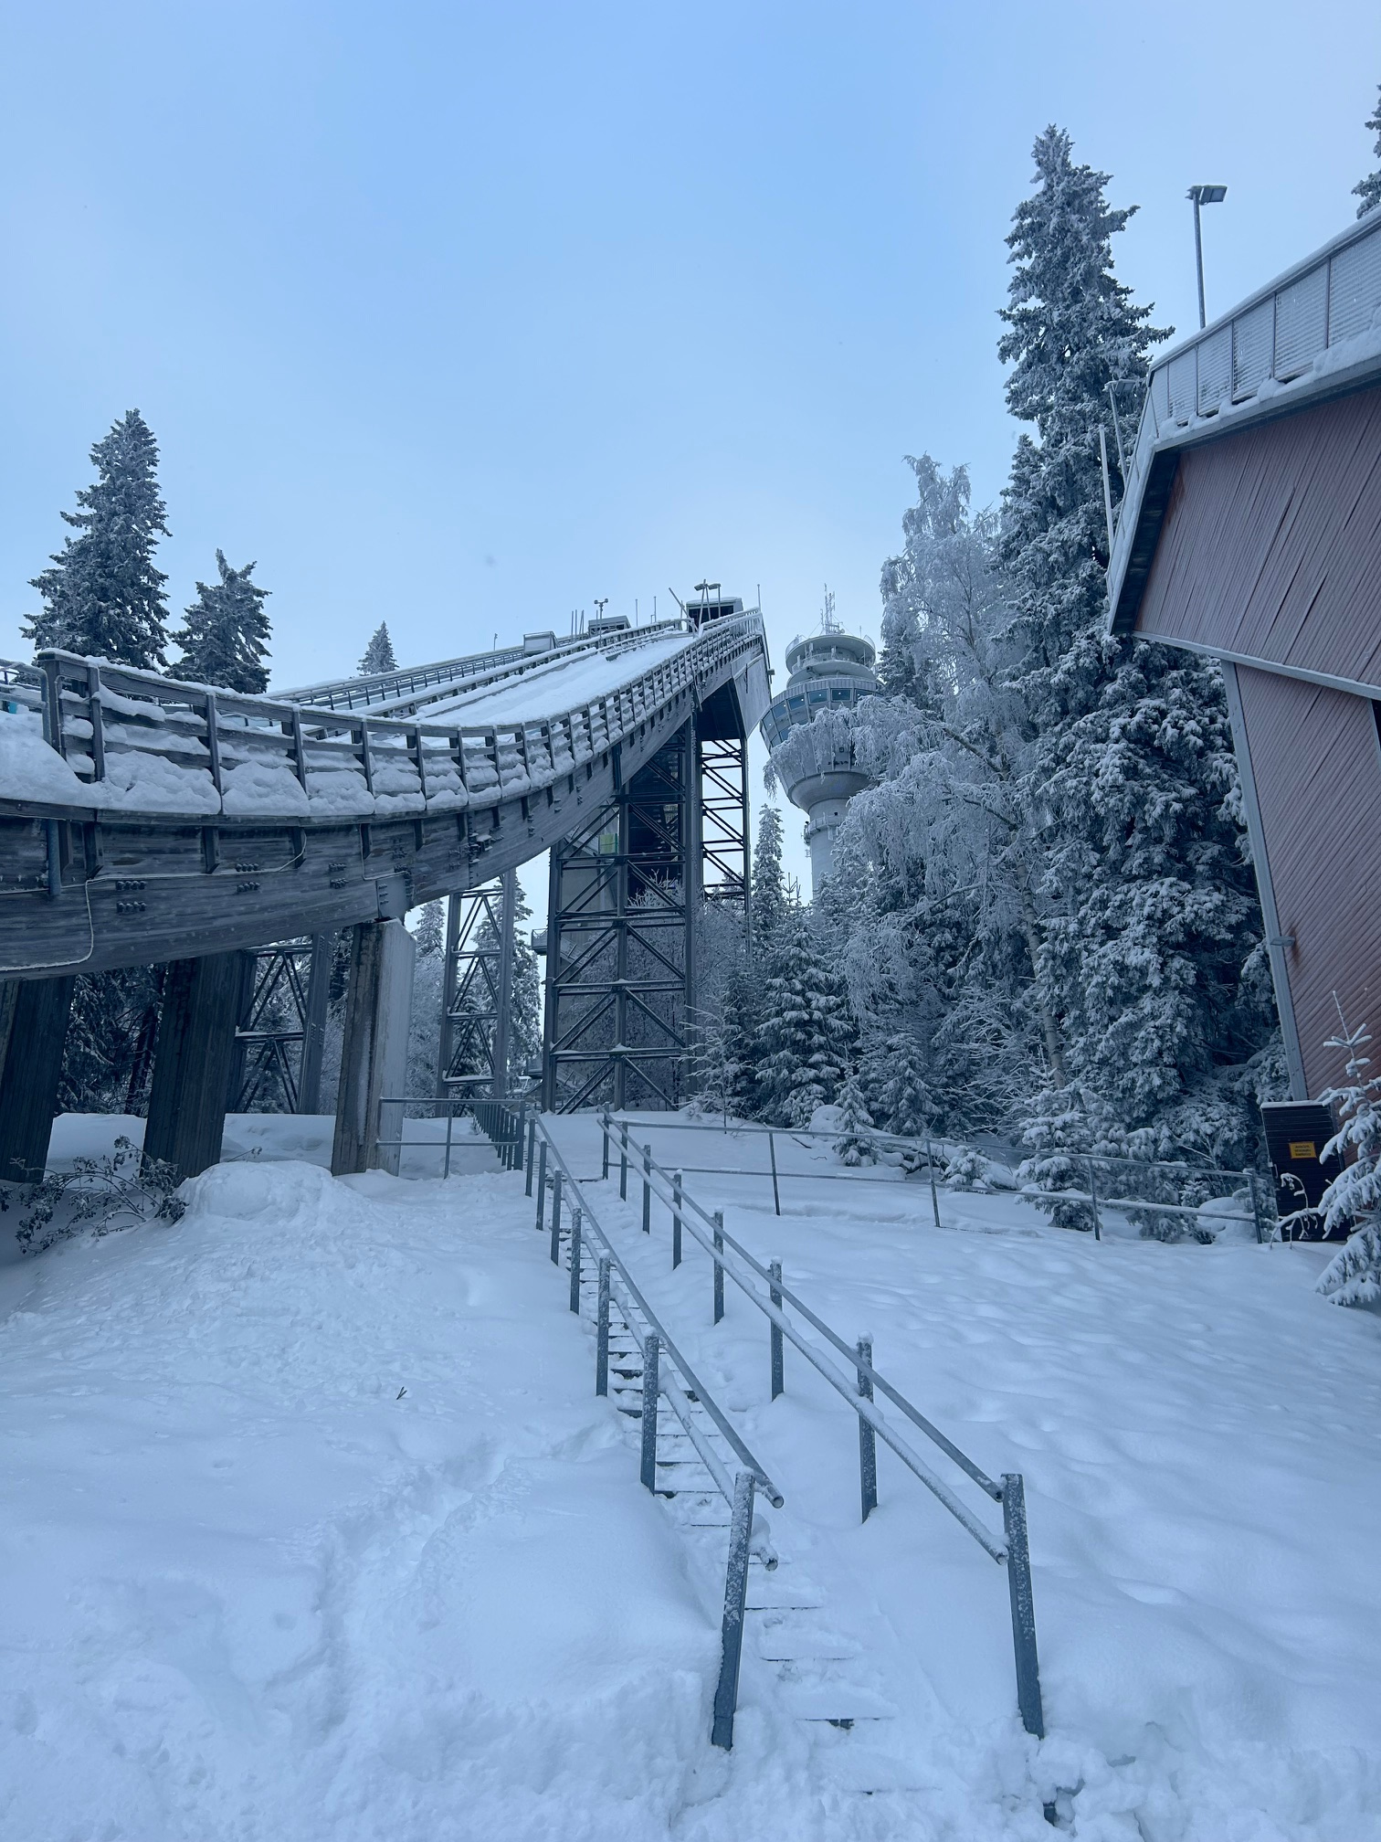
CITY ATTRACTIONS
THE HARBOUR PUIJO TOWER
MUSEUMS

Slide 6
Keeping The Balance
Joy
Life
Study

Slide 7
Difficulties
Language Barrier
Shy Finnish People
Mosquitos
Long Winter
Simple Food

Slide 8
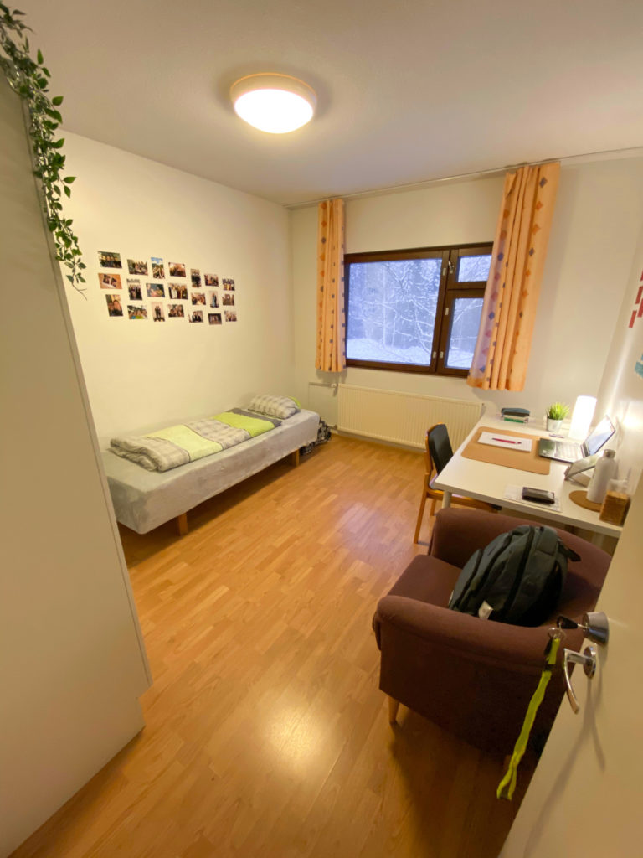
Student Housing
Kuopas
- Furnished/ Non Furnished Apartment
- Variety in Locations
- Facilities
- Budget Friendliness

Slide 9
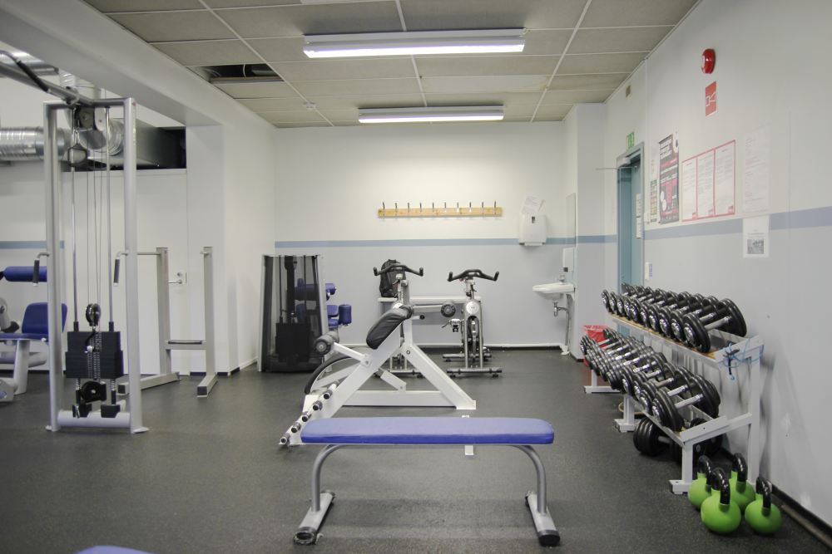
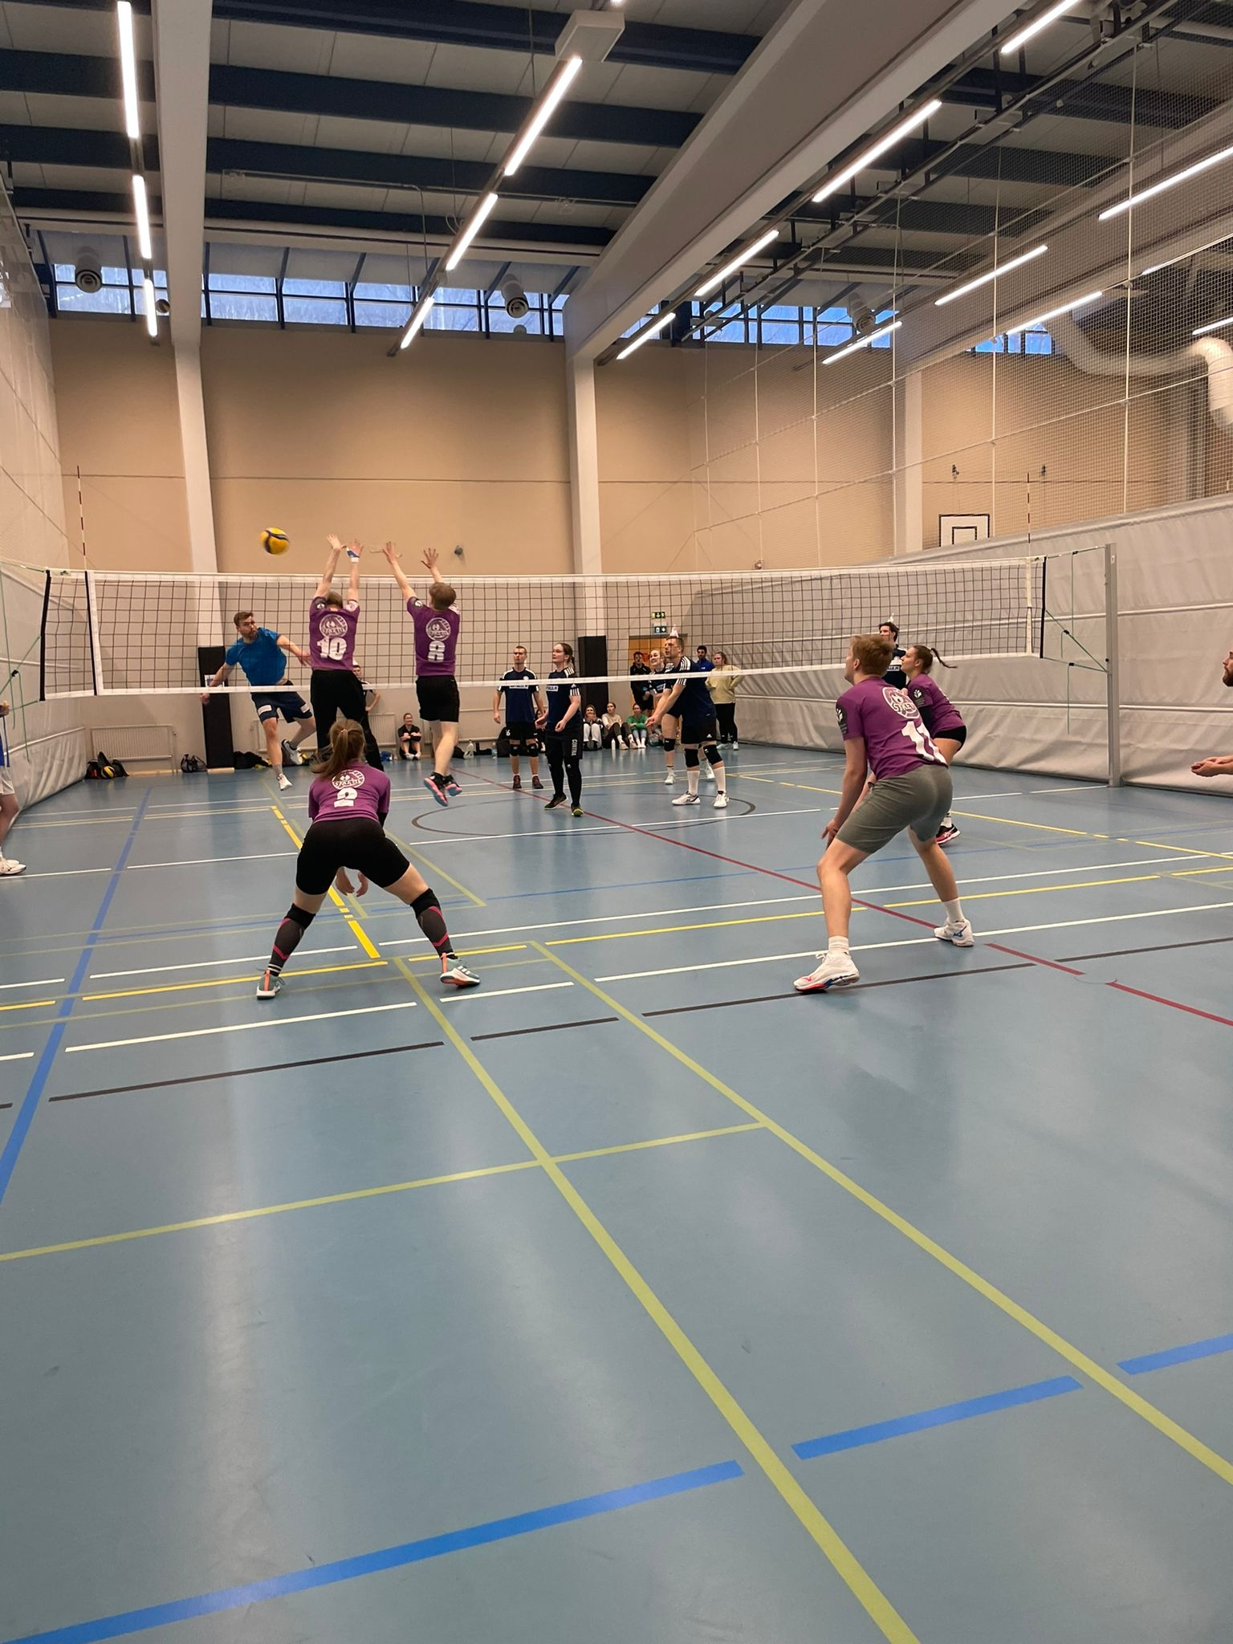
Sports Facility
SYKETTÄ - KUOPIO UNIVERSITY SPORTS
- Gym
- Badmintion
- Volleyball
- Winter Sports
- Sauna

Slide 10

Mentorship for International Students
Navigaattori (Career paths, Services for Young people, Counseling for Immigrants) - Kuopio City
Kompassi (Community work, Wellbeing) - NGO Setlementti
Talent Hub ( Match-making with Employers, Networks)
LINKS:
https://www.kuopio.fi/tyollisyys-ja-yrittaminen/tyollisyyspalvelu/navigaattori/
https://www.puijola.net/kompassi/
https://www.linkedin.com/company/talent-hub-eastern-finland/

Slide 11
Tips To Settle Down
Manage households
Focus on the priorities
Make friends
Use of Vilkku APP
Never lose an opportunity
Be open, Be yourself

Slide 12


Slide 13
Kiitos!

