Slide 1
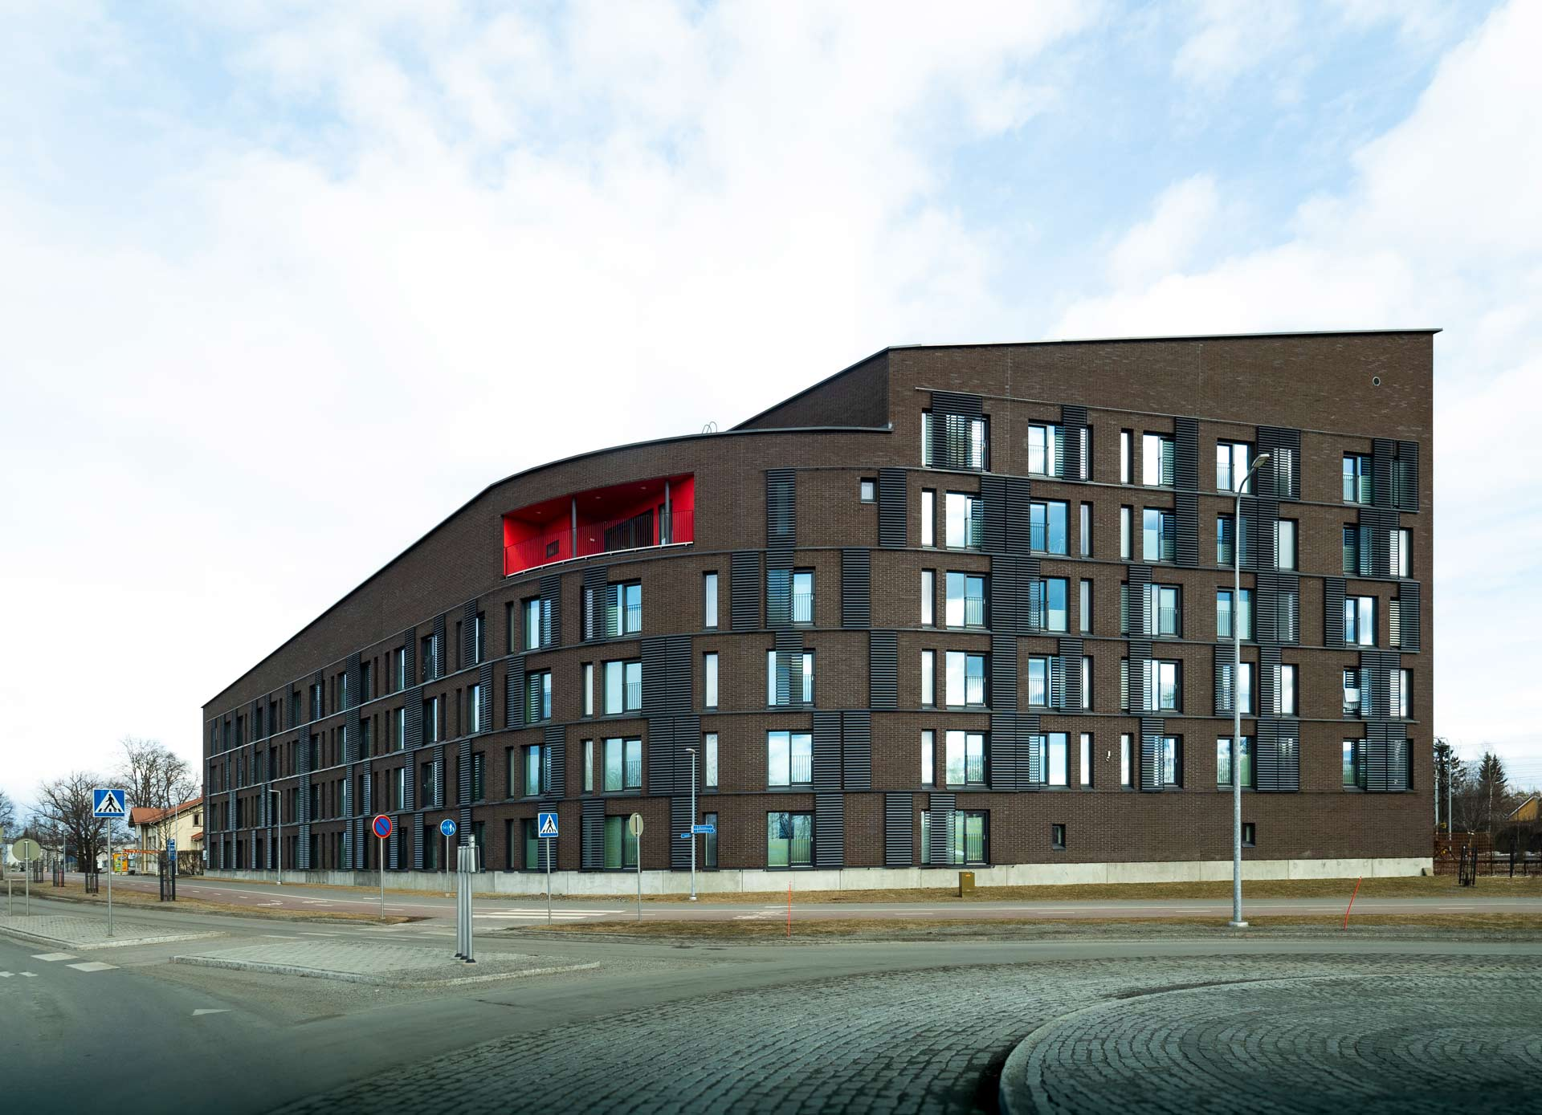

Slide 2
Joensuun Elli
Merimiehenkatu 30, 80101 Joensuu
Founded 1971
Private company owned by the city of Joensuu
Instagram: @joensuun.elli
www.joensuunelli.fi
Opening hours:
Monday – Friday | 12PM-3PM

Slide 3
CONTACT INFO
CUSTOMER SERVICE (Leases, orders; Ellinet, Sauna, parking spaces. Keys, application process)
e-mail: kodit@joensuunelli.fi
Phone: +358 13 337 7800
MAINTENANCE (Repairs and upkeeping)
e-mail: huolto@joensuunelli.fi
Phone: +358 13-3377200
RENTAL DEPARTMENT (Payments, invoices)
e-mail: vuokravalvonta@joensuunelli.fi
Phone: +358 13 337 7822

Slide 4
APARTMENTS
Normal rental apartments – no dormitories
Studios, family apartments and shared apartments
All studio and family apartments are unfurnished
Two kind of shared apartments; furnished and unfurnished
Furnished rooms are for short stay students. Apartments are located in Latolankatu in Rantakylä and Karjamäentie in Hukanhauta.
Limited amount of furnished shared apartment rooms

Slide 5
APARTMENTS
Studios are for one person only. Note the waiting time, can be even a year or more
When applying alone, apply a shared apartment room at first
Shared apartment rooms are for one person only; room cannot be shared with a friend/ accommodate any extra people
It is possible to wish the rooms from a same shared apartment with a friend by mentioning each other’s names on the applications -> We will try to fulfil the wishes if possible
Apartments are offered by the queue

Slide 6
APARTMENTS
Shared apartment room with furniture include: bed + mattress, table, chair, wardrobe and lamp on the ceiling
Elli doesn’t provide any dishes,cutlery, kitchen appliances, microwaves, pillows, blankets, etc. or rent furniture for unfurnished apartments
The furniture in the common areas are not provided by Elli. Any furniture in the common areas belong to other tenants
A fridge and oven are included in each apartment
It is separately mentioned in the housing offer and on the lease if the room is furnished

Slide 7
APPLICATION AND OFFER
Applying online on our websites after officially accepted to study in Joensuu, read the instructions before submitting the form
Set a wide search area!
Offer will be sent as soon as we are able to offer housing that matches the search. Offer is sent by email (incl. Instructions how to accept the offer and sign the lease)
After signing the lease: all the costs concerning accommodation need to be paid even if the arrival is canceled. The notice time is one calendar month.
Do not accept the offer and sign the lease, if you’re not absolutely sure about your arrival
After you’ve signed the lease, we’ll send the moving in instructions and payment info to your email
Note that leases are in full months!

Slide 8
MOVING IN
Get to know the information on the lease, all the attachments and information letter we have sent, especially our rules and regulations
Lease and terms of lease are based on Finnish law
For exchange/short stay students the leases are fixed term, others are valid until further notice. Check the dates from your lease!
One calendar months’ notice time (giving notice by online form)
Check the housing unit info on our website (e.g location of storages, laundry room, sauna…)

Slide 9
KEYS
Keys can be fetched from the key lockers in the office building’s hallway (available 24/7) or from the Elli office during the office hours
Locker information and codes will be sent to you by email (only by tenant’s request, must be requested during the office hours)
Key information on the information letter sent to you after you’ve signed the lease
The tenant can forward their personal locker information to the tutor, if wished that the tutor collects the key from the lockers on their behalf

Slide 10
KEYS
Keys are available on the first week day of the month (Mon-Fri). If the former tenant has left the apartment earlier, the keys can be fetched on the last working day of the previous month
Familiarise yourself with the locking system in your apartment. The door locks easily when the door is closed. Keep the key with you

Slide 11
KEYS
If the door gets locked: The tenant can come to the Elli office to pick up the spare key. First tenant must check whether there is a spare key left at the office
If the tenant does not have a spare key left or the office is closed, the tenant can call the on-call maintenance
If the maintenance opens the locked door, they will charge the tenant
Maintenance on call: daytime 20€, night time, weekends and holidays 40€
If the key goes missing we will automatically change the locks for the apartment on tenant’s expense. The cost is 275€ (normal key) or 55€ (electronic)

Slide 12
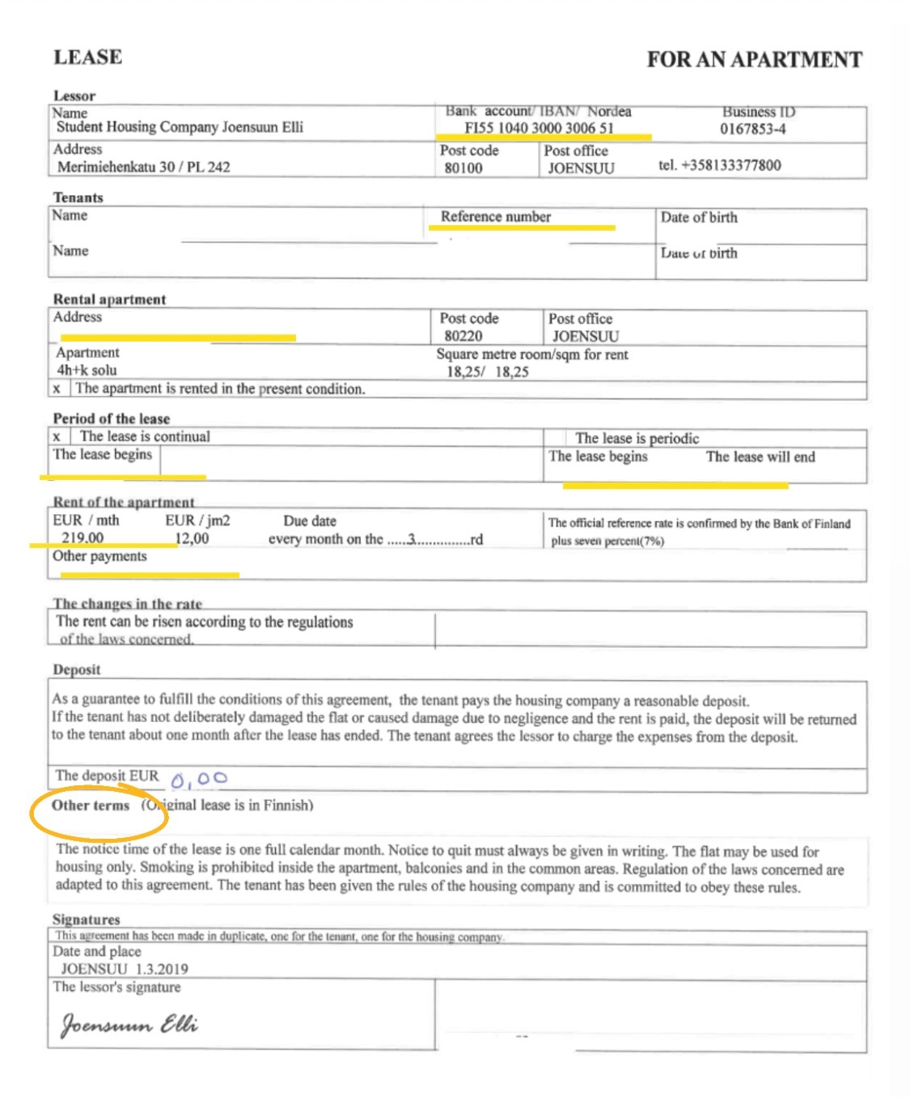

Slide 13
RENT
First rent should be paid after signing the lease, before the arrival. You do not need to send us receipts of rent payment
Due date always 3rd day of each month
Paying from a Finnish bank account: use your personal reference number (in the lease)
Paying from abroad: use the information that we have sent you via email with the lease
Remember that your full name must be seen in the payment if you pay from abroad or someone else is paying the rent for you
The rent can be paid in advance or several rents can be paid at the same time
It is not possible to pay by cash or card at the Elli office
If any questions/problems concerning with payments, contact the rental department

Slide 14
FAULTS
If there is something to report when moving in (something broken etc.), inform Elli's maintenance
If there is something that need to be fixed (not so urgent), fill the notice of defects form online
Only urgent faults: contact the maintenance on call

Slide 15
ELLINET INTERNET CONNECTION
Ellinet is not included in the rent
Payment is 20€/month, paid together with the rent
Ellinet subscription form online. Subscription is valid until further notice
Any routers or connection devices are not included in the order, instructions online
At Latolankatu 9 unit there is no Ellinet available
More information: https://www.joensuunelli.fi/en/ellinet/
If you have technical issues with Ellinet, contact helpdesk (only Ellinet matters):
tel. +358 (0)13 339 0900, email: helpdesk@joensuunelli.fi

Slide 16
LAUNDRY
Laundry rooms can be used for free
daily 7am-22pm
Turn must be reserved in advance using a list or online booking depending on the housing location
Instructions in the laundry rooms
Drying and washing machines in the laundry room
Check the location of the laundry room from the housing unit info online

Slide 17
SAUNA AND PARKING
SAUNA
Common sauna turns are free of charge once a week (mens/womens turns, normally on Wednesday)
Private sauna turn 1 hour/week, 8€/month, booking online www.joensuunelli.fi
PARKING
7-30€/month, booking online www.joensuunelli.fi

Slide 18
RULES AND REGULATIONS
Get to know them well, sent together with the lease (Welcome-letter)
Silence time from 10pm to 7am
Parties in the apartments and common areas (e.g. the laundry room, corridors etc.) are not allowed
Accommodating any extra people is strictly prohibited
Smoking is not allowed in the apartments or balconies/terraces, only outside in the marked areas
Note that breaking the rules may result in the loss of your accommodation!

Slide 19
OTHER COMMON RULES
Tenants must recycle and maintain the apartments according the instructions
In a shared apartment:
negotiate about cleaning, visitors etc.
ask permission to use others’ things
respect your roommates

Slide 20
MOVING OUT
If you wish to move out earlier than the lease is valid for or if your lease is valid until further notice, you need to give notice one calendar month before!
Email is not enough for terminating the lease, notice form online
We will send the moving out and cleaning instructions once the notice has been processed

Slide 21
WHEN YOU MOVE OUT…
The apartment must be cleaned and cleared of your belongings
Keys must be returned to the Elli office mailbox/ Elli office on time!
It is not allowed to leave the keys to the apartment. If the keys have not been returned on time or there are keys missing, the locks of the apartment will be changed at tenant’s expense (275€ normal/55€ electronic)
-> Maintenance will inspect the apartment after the key has been returned to the Elli office

Slide 22
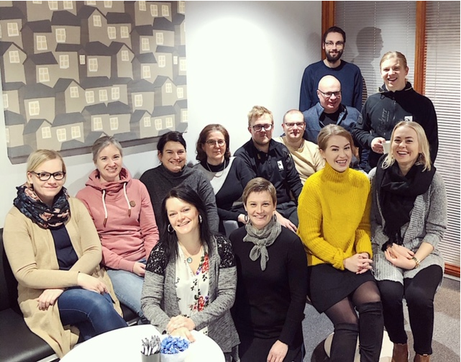
WELCOME TO JOENSUU!
and remember that you can always contact our office if you have any questions about housing! We will help you ☺

