Slide 1
Digital Services, Usernames and Access Rights
Digital Services 2026

Slide 2

IT Servicedesk
Service channels:
eservices.uef.fi
Phone: 029 445 8880
IT Servicedesk chat: eservices.uef.fi and uef.fi/dipa
E-mail: servicedesk@uef.fi
Service points: Kuopio and Joensuu
Opening hours and exceptions uef.fi/servicedesk

Slide 3
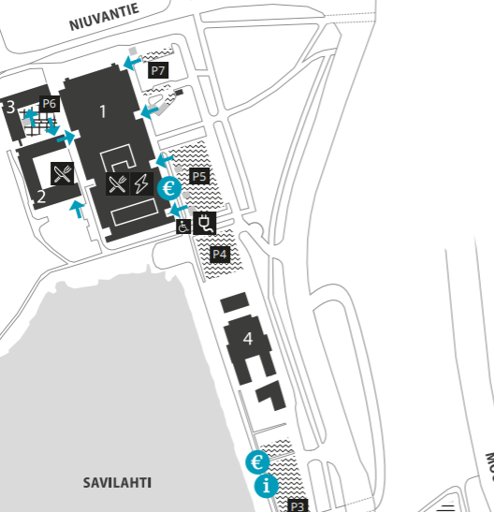
Service point Kuopio
Kuopio Canthia –building with Oppari
B-door, 2nd floor (follow the signs)
IT Servicedesk:
Monday - Friday: 10-14
Campus map:
https://www.uef.fi/en/kuopio-campus​
Canthia

Slide 4
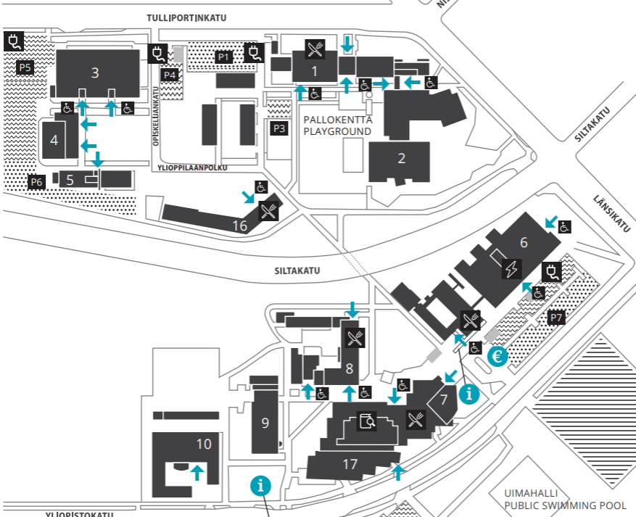
Service point Joensuu
Joensuu Carelia-building with Oppari
1st floor, in the library
IT Servicedesk:
Monday - Friday: 10-14
Campus map:
https://www.uef.fi/en/joensuu-campus​
Carelia

Slide 5
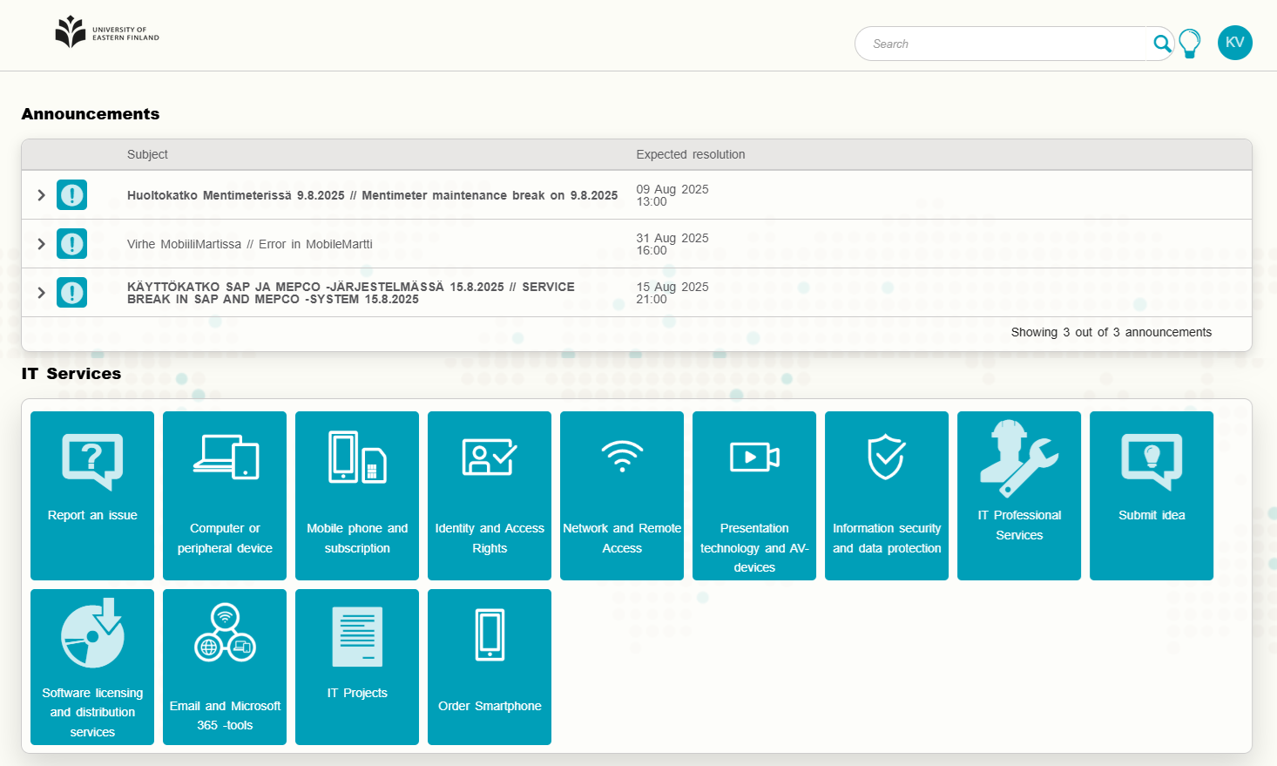
eServices
Instructions
eservices.uef.fi
You can, for example:
Submit service requests
Check known issues and announcements
Find instructions

Slide 6
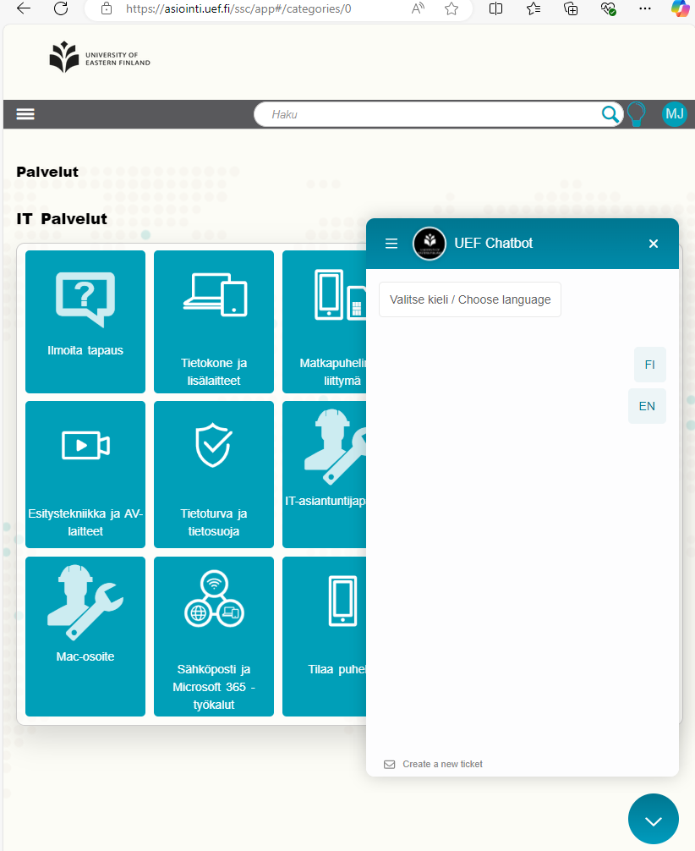
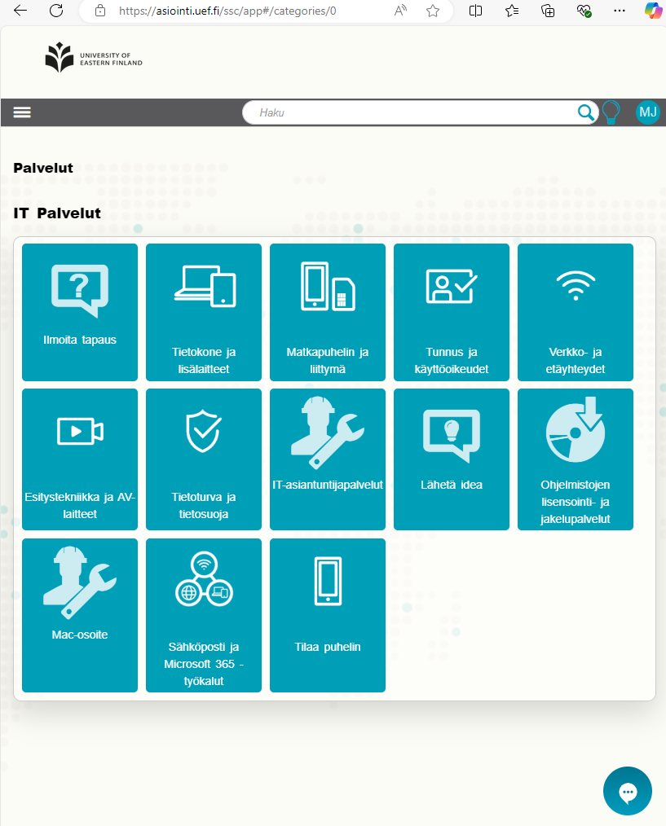
UEF Chat
You can chat with IT Servicedesk in real time.
The chat is available in eservices.uef.fi and uef.fi/dipa at the bottom right corner — click the speech bubble icon.
Please start by providing your name, contact information, and a description of the issue.
Open on weekdays from 9 AM to 3 PM.
EXAMPLE

Slide 7
UEF account and lifecycle

Slide 8
UEF account timeline example
Use Suomi.fi authentication, if possible!
Blue points: waiting for your action
White points: automatic
Detailed instructions: Study right and registration - UEF Kamu
Study right created
Account activation message from iam@uef.fi
Activation of account in uef.fi/username
UEF account ready for use
Strong identification via Candour service or visiting the IT Servicedesk
Study right begins

Slide 9
How to activate your UEF user account
You have received an automated message with your user account activation information as you have been recorded in Peppi.
If you have not received the email and you are sure you don’t have a UEF user account yet:
Check your spam folder.
If you cannot find it, contact IT Servicedesk.
Each person has only one UEF user account. If you already have one, you will not receive an email.
Activation can be done in uef.fi/username.
You will need your student number and the activation code provided in the email or Finnish online banking codes.

Slide 10
UEF account access rights
You will receive full access rights once the following conditions are met:
You have completed strong authentication (visiting our IT Servicedesk or remotely with Candour),
You have registered as present (“automatic” for exchange students),
Your study right is valid.
Degree students:
Always check the registration periods for each semester in Kamu!
If you forget to register either as absent or present, all access rights will be immediately revoked after the registration period ends.

Slide 11
UEF account access rights 2/2
Access rights as absent
Students who register as absent directly will only have access to the intranet and eLearn Moodle.
Students continuing their absence from a previous term will retain access to email and M365 services.
If you forget to register, all access rights will be immediately revoked after the registration period ends.
This includes email access, which will not be restored until you register as present again.

Slide 12
Ending of access rights
End of study right as exchange student or upon graduation
Printing rights and access to faculty-specific materials end immediately.
Other access rights remain valid for 180 days (6 months) from the graduation date / end of study right.
Your user account will be deleted after it has been closed for 90 days following the end of access rights.
Degree students note! All access rights are immediately terminated when your study right ends, or if you fail to register as present or absent during the registration period.

Slide 13
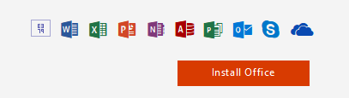
Uses of the UEF user account (for a present student)
Computers and printing services intended for student use at the university.
Microsoft 365 cloud services and Office applications.
Learning environment: eLearn (Moodle).
Student information system: Peppi.
Remote meeting software: Zoom.
Library system: Primo and remote access to library materials.
Electronic exam system: Exam.
Services of other universities that support HAKA login.
Wireless network: Eduroam.

Slide 14
UEF password
Your password is valid for 13 months. You will receive a warning about expiration in advance to your student email.
You can change your password in the following ways as described in uef.fi/password:
At Identity management self-service portal using online banking credentials or your current valid password.
At the IT Servicedesk service point with a valid ID (Finnish driver’s license, passport, EU ID card, or residence permit).
On campus student computers while logged in (press Ctrl+Alt+Del → Change a password).

Slide 15
Creating a password
Your password must include at least three (3) of the following character types:
Uppercase letters: A–Z
Lowercase letters: a–z
Numbers: 0–9
Allowed special characters: !@#$%/,.;:-_*=+?
Restrictions:
Do not include your name or parts of it, your username, date of birth, social security number, or previous passwords.
Do not use Scandinavian characters (å, ä, ö, Å, Ä, Ö).
Passwords longer than 16 characters may cause issues in some external systems.

Slide 16
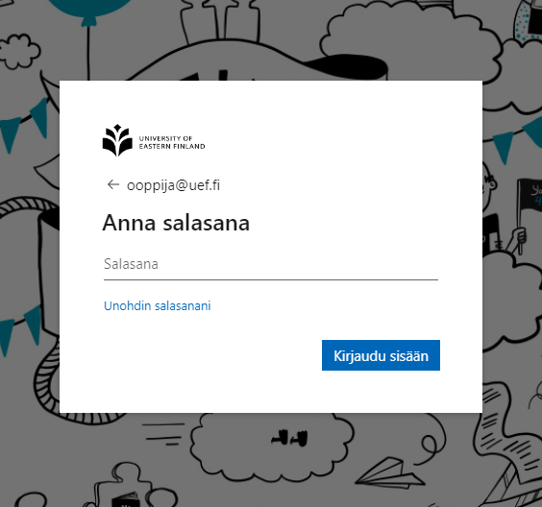
How do I log in with my UEF username?
When logging in, use the form username@uef.fi.
Email address username@student.uef.fi does not work for logging in.
Only the printers require the username without @uef.fi-suffix.

Slide 17
Multi-factor Authentication MFA 1/2
Multi-Factor Authentication (MFA) is enabled for all users logging into UEF’s Microsoft 365 services.
In addition to your username and password, authentication is completed using your mobile device. The available methods are:
Text message (SMS).
Verification code in a mobile app.
Approval notification in a mobile app.
Phone call (not recommended as the primary method).
⚠️ Do not approve a login request unless you initiated it yourself!

Slide 18
Multi-factor Authentication MFA 2/2
You must set up at least one authentication method the first time you log in to any Microsoft 365 service (e.g., Outlook). Follow the setup instructions provided.
We strongly recommend setting up at least two different authentication methods for backup.
Later, you can update your settings via the “Edit MFA authentication settings” section found in uef.fi/dipa.
MFA reset is available if you have Finnish online banking codes. Otherwise contact IT Servicedesk for strong authentication.
🔒 Keep your authentication settings up to date!

Slide 19
Microsoft 365 and software

Slide 20
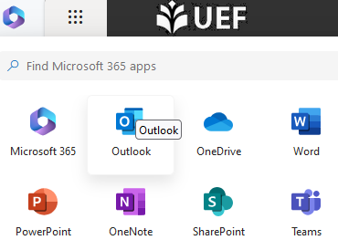

Email
When logging in, enter your username in the format: username@uef.fi
Your student email address is in the format: username@student.uef.fi
Your email address is always the primary email in UEF’s systems and cannot be changed.
You can access your email via:
outlook.office.com.
Any Microsoft 365 service via the App launcher.
The Tools page in Kamu.

Slide 21
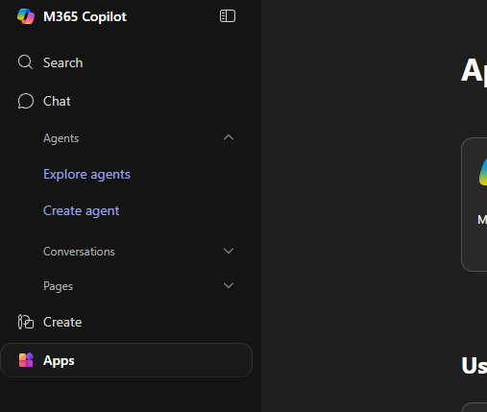
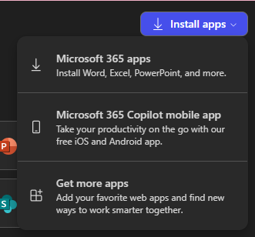
Office
Login to office.com.
Select ”Apps” on the left.
On the front right select ”Install apps” and download the software for installation.
Teams can be installed separately from the web.

Slide 22
Software for home computers
If your studies require special software, the teachers responsible for the course will know about its availability.
Examples of commonly used software (more information available on intranet):
Remote Desktop
SPSS and Amos
Matlab
Atlas.ti
You can also find free and discounted software at: uef.onthehub.com

Slide 23
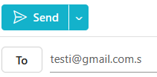
Secure mail
Communication between UEF email addresses is always encrypted.
You also have access to a secure email service, which allows you to send encrypted emails to external email addresses.
To use it, simply add “.s” to the end of the recipient’s email address (e.g. testi@gmail.com.s).
For detailed instructions, visit: intra.uef.fi → Digital Services → Information Security → Email and Secure Mail

Slide 24
Artificial Intelligence
Read about the use of AI in intra: start from the page AI FAQ.
You can use Microsoft Copilot, but you must login with your UEF account (otherwise you are using the consumer side that is not protected).
Check the AI policy of the UEF. You cannot use your UEF account or email to register to an external AI service.

Slide 25
Eduroam wireless network
You can use the Eduroam wireless network on campus with your personal devices. Eduroam is also available at many other European campuses.
Login format: username@uef.fi and your UEF password.
TIP! The easiest way to connect your device to Eduroam is to install the setup profile from cat.eduroam.org, which guides you through the necessary steps for login.
NOTE! The wireless networks UEF and UEF2 are reserved only for UEF-managed devices.

Slide 26
Information security

Slide 27
Main information security threats
Cyber criminals are mostly driven by the economic profit.
Information is valuable. It can be sold or used for extortion.
User authentication is the main control to access information.
Adversaries aim to get the user credentials by sending phishing messages, cracking weak passwords or trying with leaked passwords.
Adversaries also use software vulnerabilities.

Slide 28
User accounts, passwords, multifactor authentication
Users are personally responsible for their user accounts.
User accounts are personal, don’t share it.
If there is reason to believe that a password has been compromised, the password must be changed immediately.
Use long passwords or passphrases.
Use Multifactor authentication (MFA/2FA) when possible.
Use different passwords for different services. Compromise in one service does not expose all your services and data.
Save passwords only to a secure and trusted location.
When using shared public computers, remember to log out.

Slide 29
Devices, software and data security
You are responsible of your own devices. Keep the devices and softwares updated. Especially note web browsers and mobile devices.
Install and update software only from trusted sources.
Consider what data to save where.
For data related to your studies, it’s recommended to use services provided by the university.
For sensitive information please note UEF information processing instructions
When sharing files, verify you are sharing correct files with correct people.
Make sure to backup your important files.
More information: File storage and backup

Slide 30
Email security
When sending email verify the recipient address is correct before sending.
If you receive email addressed to someone else, inform the sender and delete the email.
UEF email is recommended to be used for all communication related to your studies.
Confidential information shall not be sent outside UEF via email without encryption. Please use secure e-mail service for sending sensitive information.

Slide 31
Phishing and Fraud
Phishing and fraud messages may aim to:
Receive reply to the message.
Have recipient to enter their username and password or to give authorization for some action.
Get approval for purchase or money transfer or just get recipient to purchase something.
Notice the signs of typical phishing or fraud: hurry, intimidation, appealing to your willingness to help, change of something or unique opportunity.
Verify the sender email address (examples on the next slide).
Check the link address before opening. Do not rush – think before you click!
Ask for assistance if you feel uncertain.
Warnings and examples are published on the Digital Sevices Viva Engage channel with topic identifier ”informationsecurityalert”.

Slide 32
Phishing – check the sender address
Firstname Lastname <firstname.lastname@uef.fi>
Serviceaddress <serviceaddress@uef.fi>
Firstname Lastname <username@student.uef.fi>
Prof. Dr. Jukka Mönkkönen <chief.professor@gmail.com>
<purchasing@uef-fi.com>
Your Manager <directleader@gmail.com>
OK

Slide 33
Reporting and contact information
Everyone is responsible for reporting any observed deficiencies in information security as well as any observed or suspected information security violations. eservices.uef.fi => IT Service => Information security and data protection
In urgent matters please contact IT Servicedesk or directly the responsible persons. Contact information is available in Intranet: Information security
More information in Intranet: information security policy, information security responsibilities, Rules of IT service use, E-mail rules, Instructions on information processing and other information security instructions.

