Slide 1

Exchange Students: Requirements and Documents for Exchange

Slide 2
Requirements and Documents for Exchange
Make sure you know the requirements of your home university.
How long you should stay? (In Erasmus the length of your study period determines the amount of scholarship.)
How many credits are required?
What kind of courses?
What kind of grades?
What kind of documents and when they should be submitted?

Slide 3
Dates on the Documents
Study period
For the Spring Semester 2026 = from 7 Jan to 29 May 2026
For the Full Academic Year = from 1 Sept 2025 to 29 May 2026
Training periods may have different dates.
Date of signature is always the date when the document is signed.

Slide 4
Documents for Exchange
On Arrival
Some universities require a Confirmation of Arrival or a Confirmation of Enrollment.
Päivi Haltilahti signs and stamps these for Joensuu and Kirsi Konttinen for Kuopio.

Slide 5
Documents for Exchange
On Arrival
The updated Learning Agreement is always signed by your departmental coordinator for exchage studies: https://kamu.uef.fi/en/student-book/study-coordinators/
If possible, please wait a bit before all the courses are settled for you and then have the Learning Agreement signed and updated for your home university.

Slide 6
Documents for Exchange
Before returning back home
Letter of Confirmation (stating the length of your exchange). UEF can issue this document seven days prior to your departure at the earliest. Please note that your home university may have different requirements for the dates.
Digitally signed Transcript of Record is available through Atomi in Peppi: https://kamu.uef.fi/en/tietopankki/forms-and-certificates/electronic-transcript-records-certification-student-status/
We will send you instructions on what to do before leaving by email at the end of the semester (Päivi in Joensuu, Kirsi in Kuopio).
Checklist in Kamu: Before departure - a checklist for exchange students - UEF Kamu

Slide 7

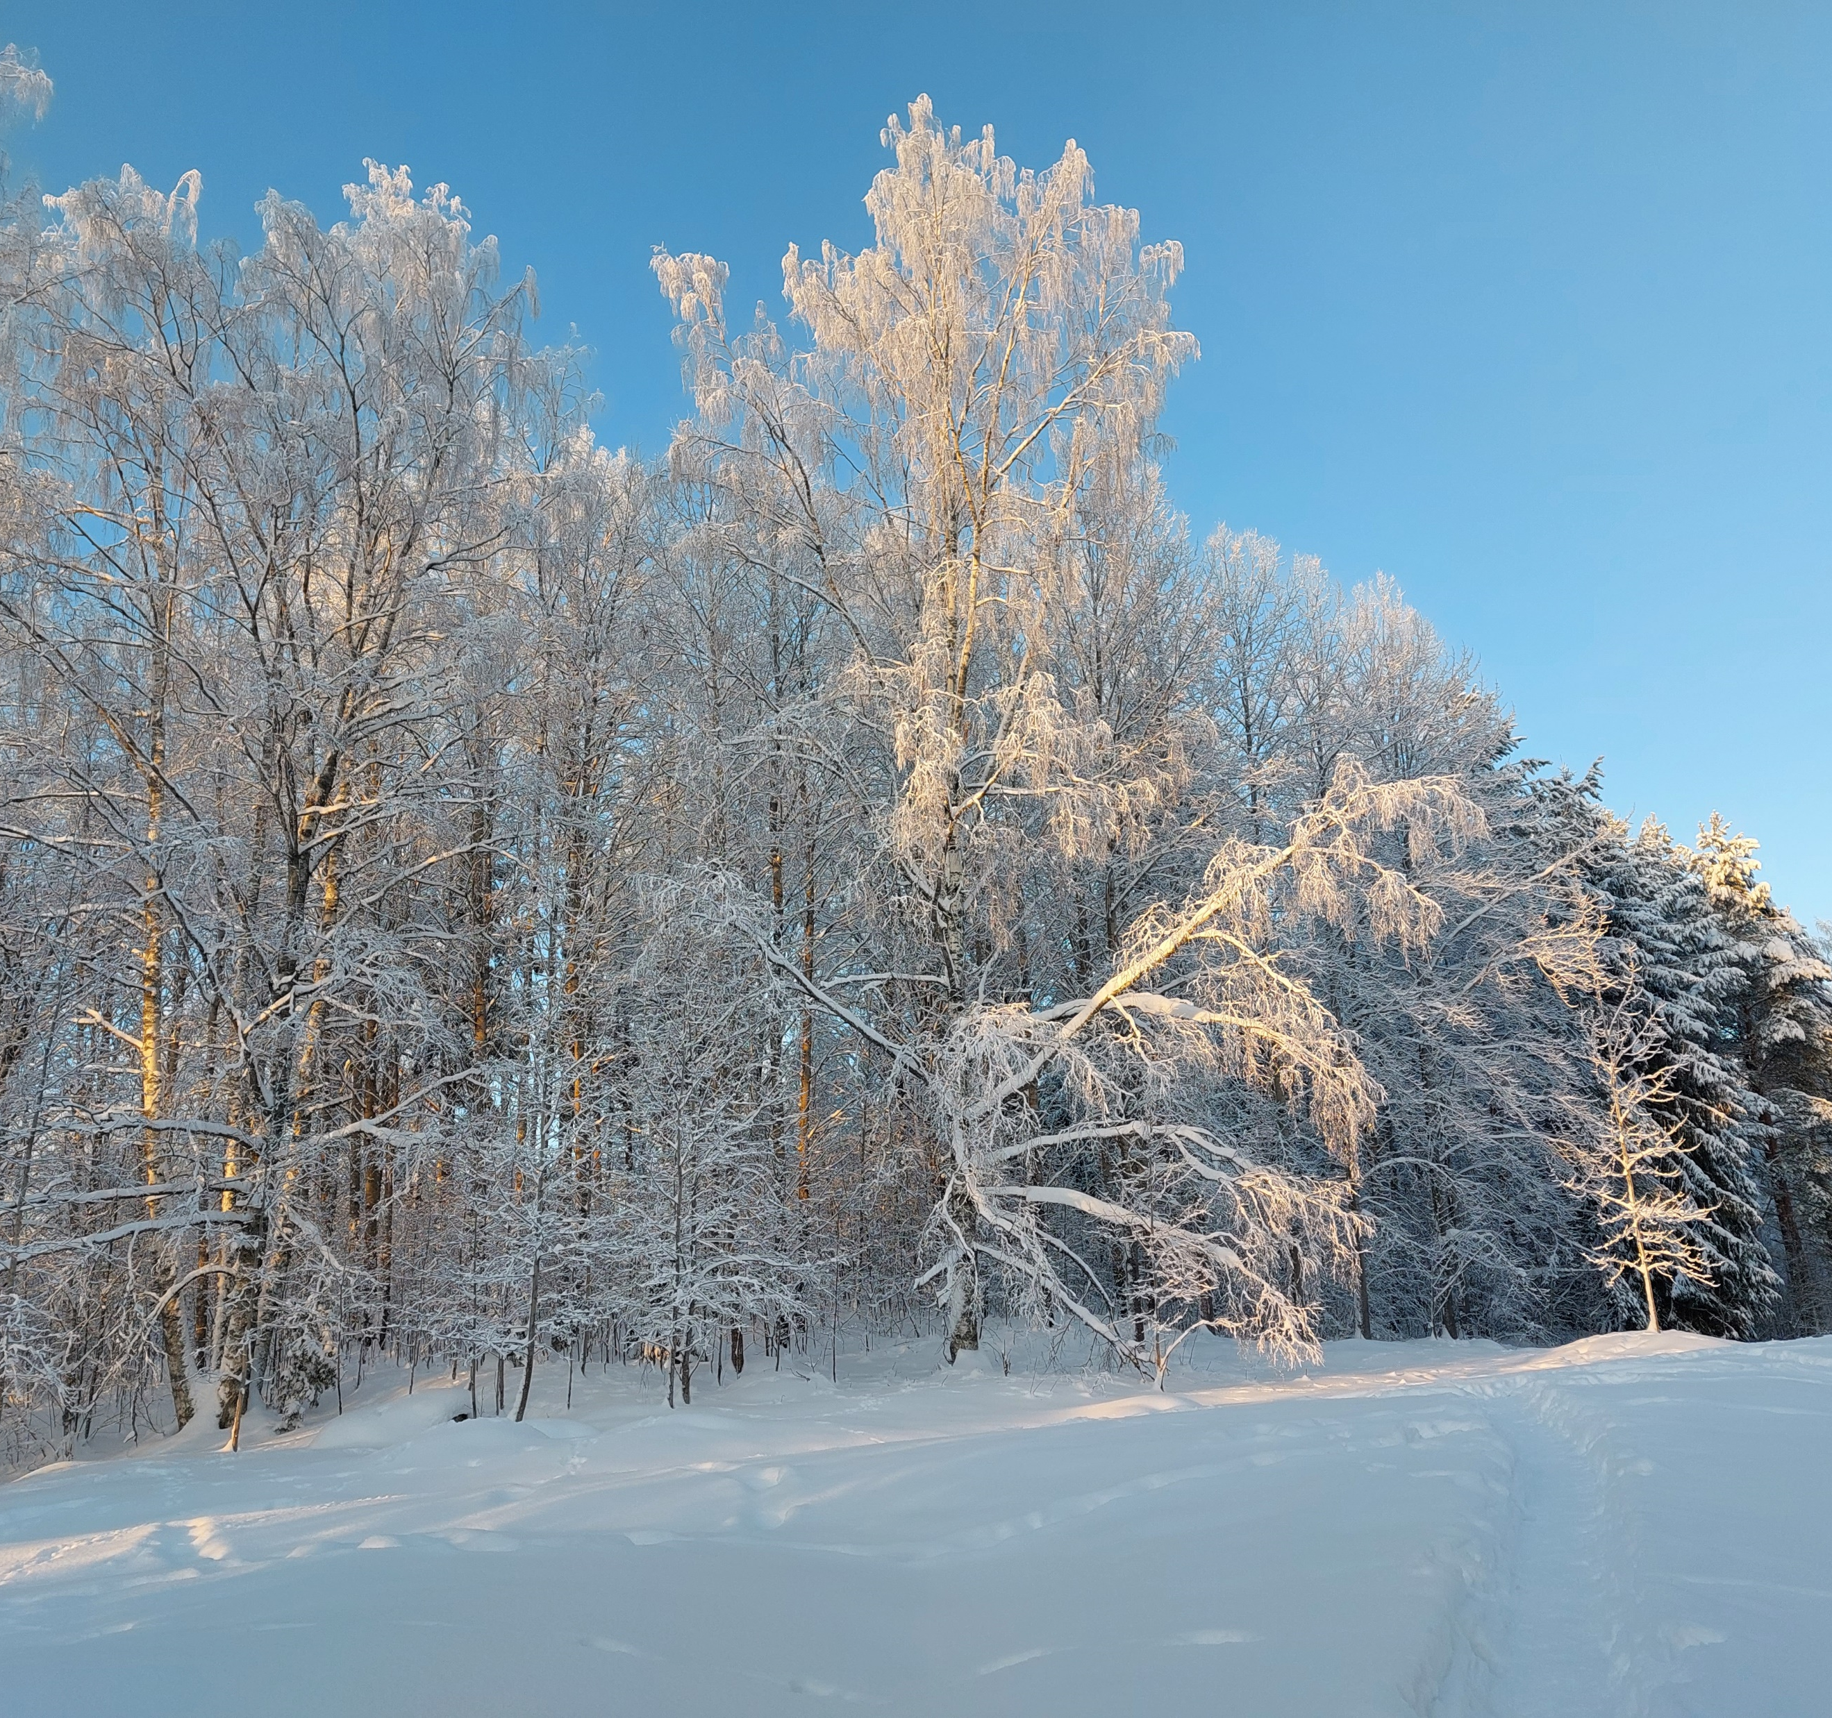
We hope you will enjoy your time with us!
We hope you will enjoy your exchange period with us!

