Slide 1
Introduction to Studying at UEF
Orientation for International Students
Kirsi Konttinen Spring Semester 2026

Slide 2




By participating in this event, you commit to principles of a safer space:
We respect
Treat others with respect and kindness. Diversity isn’t always visible, so approach the event assuming that it exists.
We take responsibility
Strive for respectful and constructive interaction. Keep the discussion on topic and avoid inappropriate comments. Making mistakes is human, and asking questions is always allowed: Accept the feedback you receive, apologize if needed, and learn from others.
We listen
Listen actively to others' contributions and give space to all participants. Do not interrupt or belittle others' views. Accept others' opinions, new topics, individuals, and perspectives with an open mind.
We intervene
If possible, intervene in any inappropriate behavior you notice. Everyone has the right to feel safe and valued. Inform the event organizer if you feel uncomfortable or observe inappropriate behavior. A person who is harassing or acting inappropriately may be removed from the event if necessary. After the event, you can report the issue via email:
Kirsi Konttinen, kirsi.konttinen@uef.fi
Päivi Haltilahti, paivi.haltilahti@uef.fi

Slide 3

Topics
Basics on studying
Study system in general
How to start your studies?
How to comple courses?
Exams, credits, grading
Wellbeing of students
Inappropriate treatment and harassment
Student’s rights and obligations
Accessibility in studies
Individual study arrangements

Slide 4

General about Studying
Finnish system is probably very different from what you are used to.
Flexible and independent
Independence : students have a lot of freedom to plan and organize your studies.
No supervising on your daily activities.
This brings a lot of responsibility, too.
You are responsible for managing your studies but help is available. – Be active!

Slide 5

General about Studying
Low hierarcy
The UEF staff is there to help the students.
Not just memorizing the knowledge but being able to apply the knowledge?
Username and access to online environments are essential.
All materials are online.
ELearn (former Moodle) and Teams are platforms for course materials.

Slide 6
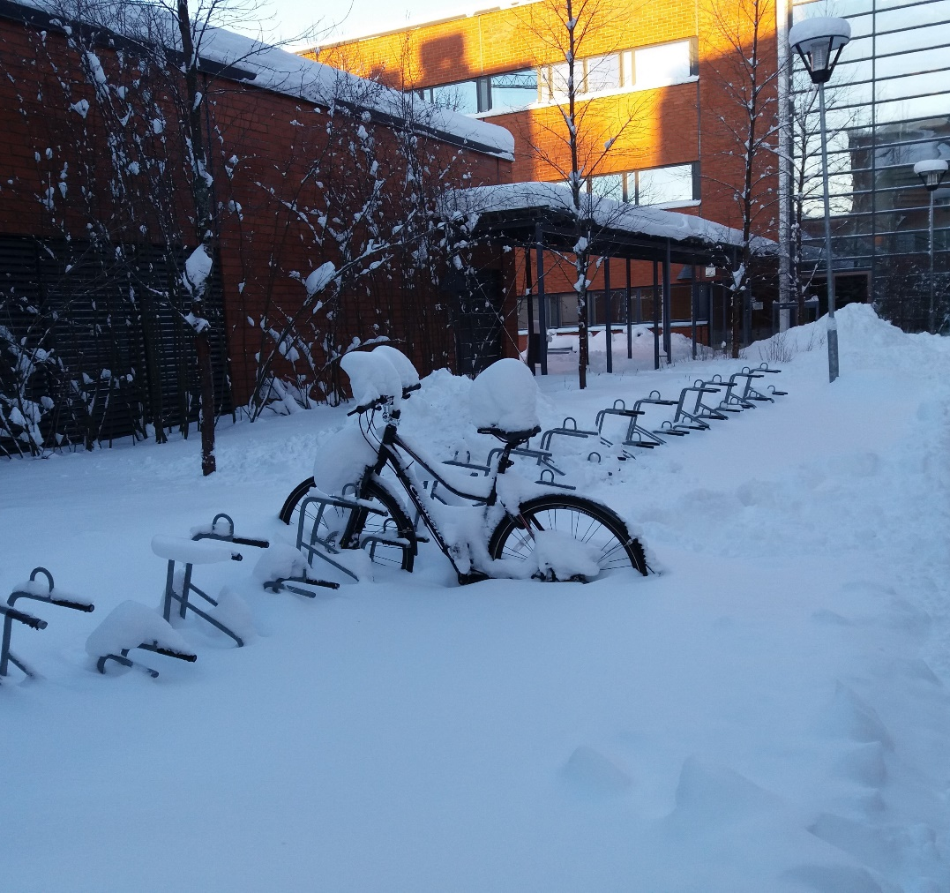
General about Studying
It takes time and energy to understand the new systems.
It takes time and energy to adjust.
Uncertainty and confusion are a part of the experience, especially at the beginning.
Take it easy, everything will be ok.
You can sort out things little by little. And please remember that help is always available! ☺

Slide 7

Face-to-face or online?
Some teaching is organized online.
Some courses or sessions are face-to-face.
This varies from course to course. You will get the information on the courses from Peppi or from the teacher of the course.
Some courses may include both online and face-to-face sessions.

Slide 8
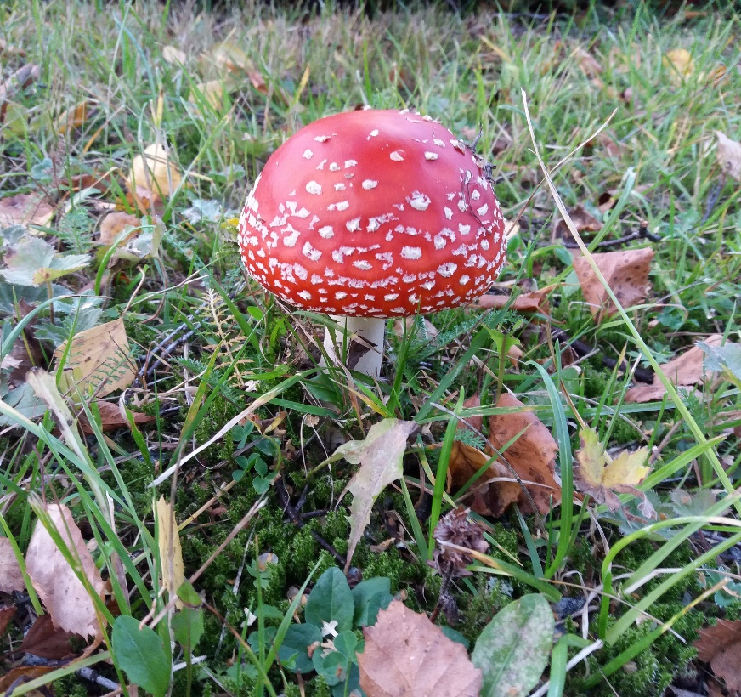
Online Studying
Studying in a new system requires an active approach from you. Studying online might require even more activity, concentration and self-regulation.
Make sure you read the info materials for courses and always ask when something is not clear.
Whenever possible keep in touch with your student colleagues, too. Studying online doesn’t mean you have to study alone – Study together!

Slide 9

Support for Online Studying
Digistartti (UEF username needed for completing the assignments) includes information on all online tools for students:
https://kamu.uef.fi/en/tietopankki/new-students/uef-digistart-course-for-new-student/
Online learning: https://kamu.uef.fi/en/tietopankki/planning-and-completing-studies/distance-and-online-learning/

Slide 10
How to Start Your Studies? https://kamu.uef.fi/en/tietopankki/new-students/orientation-for-international-students/
Join the orientation!
1. Study the orientation material
in Kamu https://kamu.uef.fi/en/new-students-orientation/
2. Join the general orientation
webinars at 12-16 local time (EEST, UTC +2) on 7 and 8 Jan, and
face-to-face on campus at 12-16 on 9 Jan
3. Follow the orientation webinar of your field if organised
Your programme coordinator has sent you the schedule and the link for the orientation meeting(s) of your field

Slide 11

How to Start Your Studies?
Exchange students
Your Learning Agreement is the starting point.
You can register for the courses you have listed in your LA and make your schedule in Peppi. You can see your timetable in Tuudo, too.
If you wish to change the courses, please talk to the departmental coordinator for exchange studies. https://kamu.uef.fi/en/tietopankki/planning-and-completing-studies/study-coordinators/

Slide 12
How to Start Your Studies?
Bachelor’s and Master’s degree students: Degree Structure
Your programme coordinator can advise you with the structure of your programme: what courses to take and when.
major subject, minor subject(s)
different tracks/options
compulsory studies, optional studies, training
Bachelor’s or Master’s thesis

Slide 13

How to Start Your Studies?
All the course information and the course schedules are in Peppi = our student and study register peppi.uef.fi
Questions on single courses, please contact the teacher of the course.

Slide 14
Course Registration
Pre-registration for courses is usually required in Peppi.
Please register for the orientation in Peppi by 31 Jan. Course code 1131003-3011.
UEF username and password are needed in order to access the systems, for example registration for courses can only be done with UEF username.
If you haven’t registered for a course in time, you can try to ask the teacher of the course whether there is room for you on the course.
Don't count on this but always try and register in time!

Slide 15

Attending the First Lecture
It is important to attend the first lecture/session of the course.
You will find out all the important information about the course, such as
the requirements for passing the course
what is compulsory and what is optional
the teaching methods
the assignments, the literature and material
exams etc.

Slide 16

Attending the First Lecture
Contact the teacher if you can’t join the first session of the course.
Each course has different requirements for passing. Make sure you know them.
If you have overlapping courses, talk to the course teachers and try and solve the problems with the course schedules.

Slide 17
Different Ways of Completing Courses
Traditional ways of contact teaching (lectures, seminars, exercises, presentations, projects, demonstrations, lab work)
Some courses have exams, some have assignments or projects instead.
We have no exam periods/weeks, but the exams are usually at the end of each course. Mid-exams are possible, too.
Attending lectures can be optional but often it is essential for passing the course.
Lab work, exercises, group work etc. is always obligatory.

Slide 18
Different Ways of Completing Courses
The number of contact hours in teaching does not determine the number of working hours. Courses usually include a great deal of independent work and thinking.
readings
different assignments (reports, essays, learning diaries, portfolios)
presentations
group work

Slide 19
Different Ways of Completing Courses
Stay in your own lab group, do not change groups without talking to the teacher.
If you know you will be absent (especially from a compulsory class), please discuss this with the teacher in advance.
Students in Clinical Medicine: please do not skip teaching because of trips. You are expected to do the travelling during the holidays.

Slide 20
Attending Teaching
Traditionally the lectures begin quarter past the hour (for example 8.15) and last for 45 minutes. Double lectures are common.
Whereas the lab work often starts sharp on the hour (eg. 8.00).
Online teaching can start sharp on the hour or quarter past. Check with the teacher!
The course material is usually in an online platform, for example eLearn or Teams. A UEF username is needed.
The length of courses may vary a lot. They may last for two days or for 4 months.
In some fields the semester is divided into 2 periods.

Slide 21
Attending Teaching
Remember to ask and find out. Be active!
Make sure you read the instructions and check the information which is available. If something is not clear or if you are not sure, please ask.
UEF staff is helpful. However, make sure not to misuse the helpfulness/flexibility of the teachers.
Helpfulness and flexibility does not mean that UEF staff doesn't expect you to do your share of the work.

Slide 22
Attending Online Courses
Courses and their requirements vary a lot. Make sure you know the course requirements and schedules.
In online courses we often have advance assignments. Make sure you always do the advance assignments/readings beforehand so that you will be able to make the most of the contact teaching and to ask anything that is not clear to you.
Online courses are often even more independent and require more responsibility.
Be active: read the instructions and ask if something is not clear.

Slide 23
How to Manage the Schedules?
1 ECTS covers about 27 hours of studies in general.
At first it might be a bit difficult to estimate how much time you need for different assignments start as early as possible.
Starting early also helps when you have several assignments at the same time.
The amount of contact teaching does not determine the amount of work.

Slide 24

How to Manage the Schedules?
Independent studying forms a big part of studying
If possible, always familiarize yourself with the topic already before the contact teaching.
Try and follow the deadlines always.
If you cannot meet the deadline for an assignment, contact the teacher to negotiate what to do.

Slide 25
Exams
No exam periods
Final exams at the end of the course
sometimes pre- or mid-exams
Electronic exam: please read the instructions carefully before going to the exam: https://kamu.uef.fi/en/tools/electronic-exam-facilities/
Supervised electronic exam
BringYourOwnDevice (BYOD) exam
Unsupervised electronic exam: Moodle exam or Open exam
Traditionally no oral exams

Slide 26
Exams
Open book exams are possible
You have access to all the materials during the exam.
This is always informed before the exam.
Book Exams are common
= independent studying = you study a book/books and take an exam on them
≠ open book exam
usually on general exam days (~once a month)
discuss the possibility with the course teacher

Slide 27

Exams
Registration for the exam required in Peppi by the deadline
not the same as course registration
always check with the course teacher
If you wish to take an online exam in the EXAM system, you should book a time and a room for that after registering in Peppi: EXAM Guidelines - UEF Kamu
You can retake examinations
usually two or three re-exams per course
not necessarily during the same semester

Slide 28
An Example of an Exam
Exams can be different in each course - check with the teacher!
An example of an old exam in Cognitive Neuroscience:
Each question yields 6 points resulting in a maximum of 30 points. You need to gain 15 points to pass the exam.
Describe projection by projection the multiple steps of visual information processing from retinal ganglion cells all the way to the inferotemporalcortex.
What is the difference between classical and instrumental conditioning? Give an example of each type.
3. What is the role of prefrontal cortex in cognition? (use ~ one page for the answer)
4. What is the contribution of the following brain structures to long-term memory?
a) amygdala
b) Perirhinalcortex
c) Hippocampus

Slide 29
Attending a Traditional Exam in a Classroom
Be on time!
roll-call begins often 15 min. before announced time
supervisors will assign the seat for you in the exam room
the actual exam usually starts sharp on the hour (ie. 8.00 not 8.15)
No students are allowed in the exam room 30 min. after the start of the exam
You can leave the exam room 30 min. after the beginning of the exam at the earliest

Slide 30
Attending a Traditional Exam in a Classroom
No bags, coats, mobile phones or other extra items
only a pencil and an eraser and your student card/ID
dictionaries, calculators etc. allowed only if the lecturer has given the permission and has notified the exam supervisors about
Do not read the exam questions or start writing before the supervisor has given a permission to start the exam
usually after everybody has received the exam papers
You are not allowed to leave the room during the exam
going to toilet only with a supervisor
Strictly NO talking at all during the exam!
Strictly NO extra items in the exam!

Slide 31

Cheating in an Exam?
For example any communication with others in the exam room or bringing extra material with you is considered cheating.
Cheating is considered a serious offence at Finnish universities
It will be reported to the Dean (also if cheating is found after the exam).
Even a suspicion of cheating is taken very seriously.

Slide 32
Cheating in an Exam?
The supervisors have the authority to ask you to leave the exam room if they consider your behaviour inadequate.
If you have any questions, please get the exam supervisors attention by raising your hand and ask them.
A student found cheating in an exam will be removed from the room immediately.
Serious consequences on cheating and plagiarism.

Slide 33

Plagiarism?
Plagiarism means
Copying somebody’s ideas, thoughts, texts, presentations, inventions etc. and presenting them as one's own.
The reader should be able to see what parts of the text are from you and what are based on books/other material.

Slide 34
Plagerism?
Always an insult to a good scientific practice and to the teacher in question
Use references – learn the correct referencing technique for all the written assignments!
Using Artificial Intelligence applications? Please check this with the teacher of the course: https://kamu.uef.fi/en/tietopankki/students-rights-and-obligations/the-use-of-ai-in-teaching-and-research/
The reader should know the sources and how AI has been used.
Turnitin, an electronic plagiarism detection tool is available for students, too: https://kamu.uef.fi/en/tools/electronic-plagiarism-detection-tool/

Slide 35
Plagerism?
Plagiarism is considered a serious offence at Finnish universities
It is punishable and will be dealt with even in minor cases.
Consequences
talking-to
will reported to the Dean
even the expulsion from the university

Slide 36
Assessment and Results
Within three weeks after the exam/final deadline
entered into student register (Peppi) shortly after the publication of results
notification by email
takes longer during the holidays (Christmas, Easter, summer)
Evaluation usually based on
how well the student has reached the aims set for the course
no statistical comparison (all can fail / get the best grade)

Slide 37
Assessment and Results
Many courses are graded by using only pass/fail scale (course passed/ accomplished):
no grading scale applied (meaning that course can be excellently, well or sufficiently passed)
Pass = course completed successfully, no grade is given

Slide 38
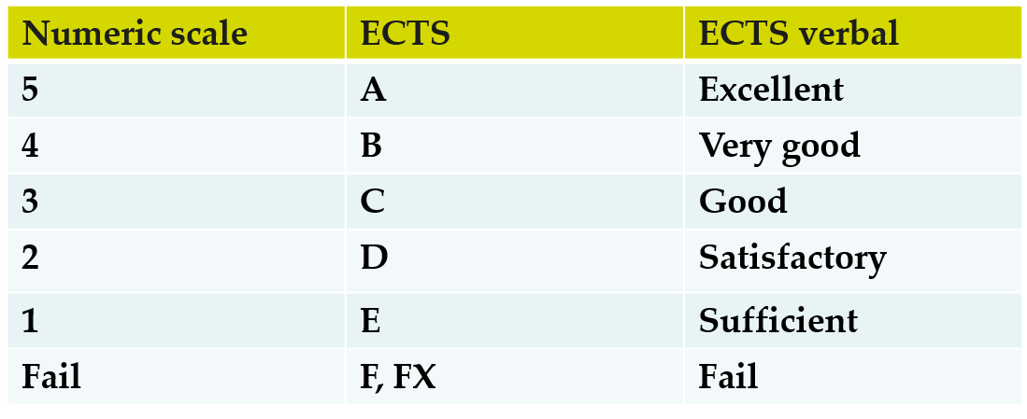
Assessment and Results
Grading scale

Slide 39
Transcript of Records
Listing the courses you have completed at UEF
You can check your transcript in Peppi
An official, digitally signed transcript is available through Atomi in Peppi directly. It is official only as a PDF document, not as a paper-printed copy.
An official paper-printed Transcript (with stamps and signature) is available from the Student Services office
Joensuu Campus: Student Services, Aurora, Entrance A, ground floor
Kuopio Campus: Oppari, Canthia 2nd floor
By email: opiskelu@uef.fi

Slide 40
Feedback
https://kamu.uef.fi/en/have-a-say-and-give-feedback/
Course feedback
Giving and getting feedback
Feedback from teacher is not always automatic
ask for it as it is the best way to learn
Feedback from students to teachers
Students can, and they should, give feedback on the courses.
Course feedback is collected through Peppi.
Feedback is given anonymously.
Vital for developing teaching

Slide 41

Wellbeing of Students
Student’s rights and obligations
Inappropriate treatment and harrassment
Individual study arrangements

Slide 42
Student’s Rights and Obligations
All UEF students have the right to study in a safe and comfortable environment.
UEF has zero tolerance for any type of inappropriate treatment, bullying and harassment.
https://kamu.uef.fi/en/tietopankki/students-rights-and-obligations/inappropriate-treatment-and-harassment/

Slide 43
Student’s Rights and Obligations
Students’ legal protection
https://kamu.uef.fi/en/tietopankki/students-rights-and-obligations/ Including for example
the use of AI, consequences of inappropriate behaviour, study regulations, individual arrangements, early support and guidance, education regulations, data protection, instructions for appeal, accessibility in studies, ethical guidelines for teaching and studying, …

Slide 44
Student’s Rights and Obligations
Ethical guidelines for teachers and students https://kamu.uef.fi/en/tietopankki/students-rights-and-obligations/ethical-guidelines-for-teaching-and-studying/
The students’ main goal in studying is to learn and achieve their learning goals.
The students are aware of their role as a responsible actor in the scientific community.
If necessary or in doubt, the students ask for more information on the correct procedures, using their own initiative.

Slide 45
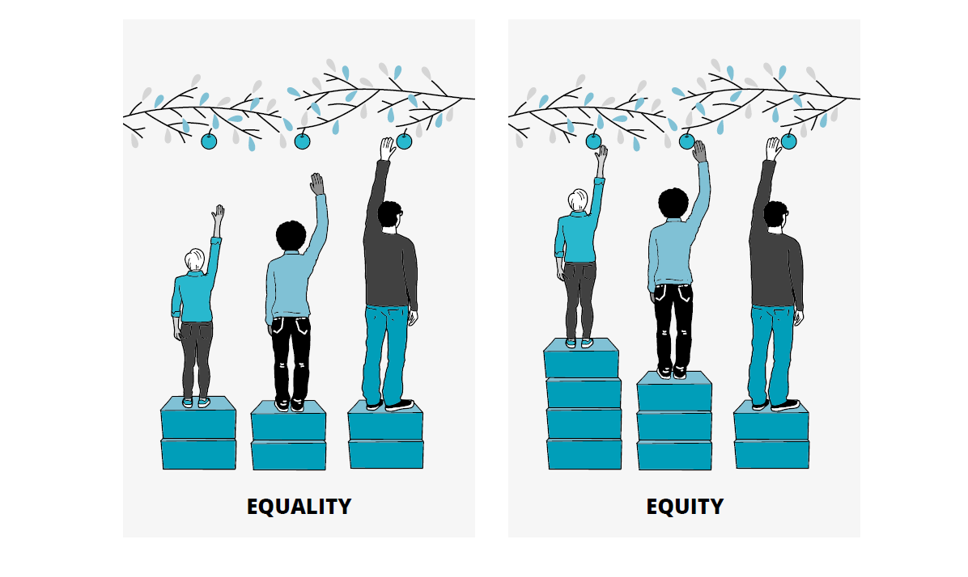
Accessibility in Studies https://kamu.uef.fi/en/tietopankki/students-rights-and-obligations/accessibility-in-studies/

Slide 46
Individual Study Arrangments
With individual study arrangements, a person with a disability or a health problem is placed in an equal position in relation to other students.
In practice study arrangements are personal solutions for achieving the learning outcomes of a course. The arrangements are aimed at the methods of completion, and do not change the learning outcomes of the course.

Slide 47
Accessibility in Studies https://kamu.uef.fi/en/tietopankki/students-rights-and-obligations/accessibility-in-studies/
Requesting individual study arrangements
https://kamu.uef.fi/en/tietopankki/students-rights-and-obligations/individual-arrangements/
Students who have an impediment or a disability can request individual arrangements.
If you need individual arrangements for your studies, you can request them by filling out the Individual Study Arrangements Form.
If you need assistance or advice on how to request individual study arrangements, please contact the accessibility contact person of your campus or faculty, or your programme coordinator.
The teachers are responsible for implementing the arrangements in their teaching.

Slide 48
Examples of Individual Study Arrangements
Time: extra time in an exam, extra time for returning learning assignments
Place: a separate, quiet exam room
Guidance: more guidance for an assignment or for theses
Pedagogical solutions: a different way of completion, a learning assignment instead of an exam, or vice versa.

Slide 49
More Information
https://kamu.uef.fi/en/tietopankki/students-rights-and-obligations/individual-arrangements/
Student Well-being Specialist, Special Education Teacher
Tiina Juurela, tiina.juurela@uef.fi

Slide 50
Problems with Studies?
The staff is there to help you. You are welcome to contact your professors and teachers by e-mail and make an appointment.
Remember that online meetings are possible, too.
You can also contact
your Programme Coordinator/Departmental Coordinator
International Mobility Services (Päivi in Joensuu, Kirsi in Kuopio)
Student Services
Student Tutors
Student Union
Study Psychologist (for degree seeking students)
Your fellow students!

Slide 51
Problems with studies?
https://kamu.uef.fi/en/tietopankki/student-life-and-well-being/
https://kamu.uef.fi/en/tietopankki/assistance-advice-and-crisis-situations/help-in-crises/
It is always more difficult and time consuming to study in a foreign language and in a new system.
Talk to other students, maybe you can solve it together.
Don’t be too hard on yourself, be patient.
Study the best you can and remember to relax and enjoy yourself, too!

Slide 52
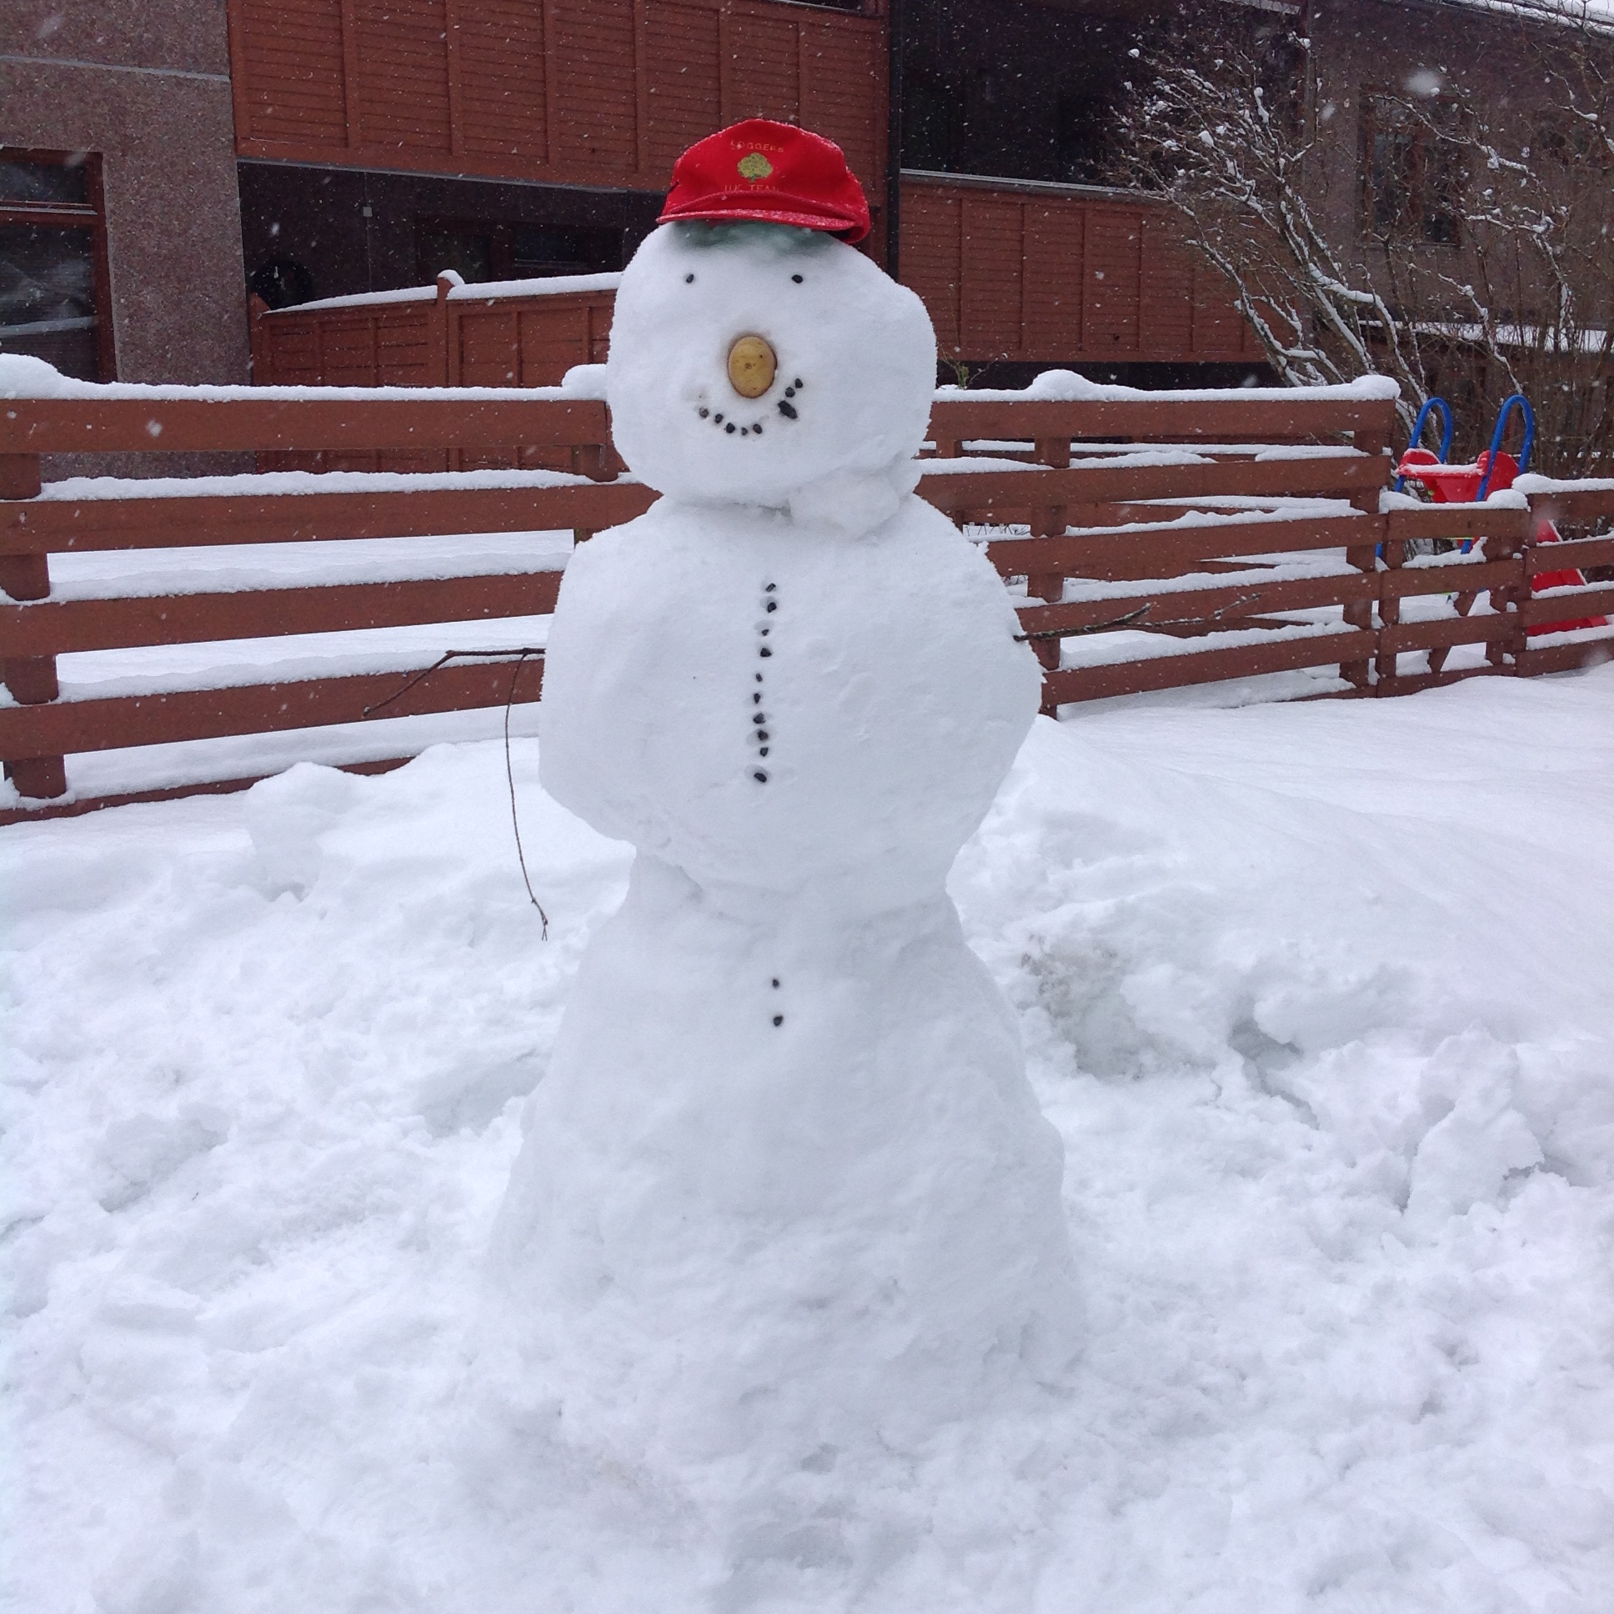
We hope you will enjoy your time and studies with us! ​
I hope you will enjoy your time and studies with us!

