Slide 1

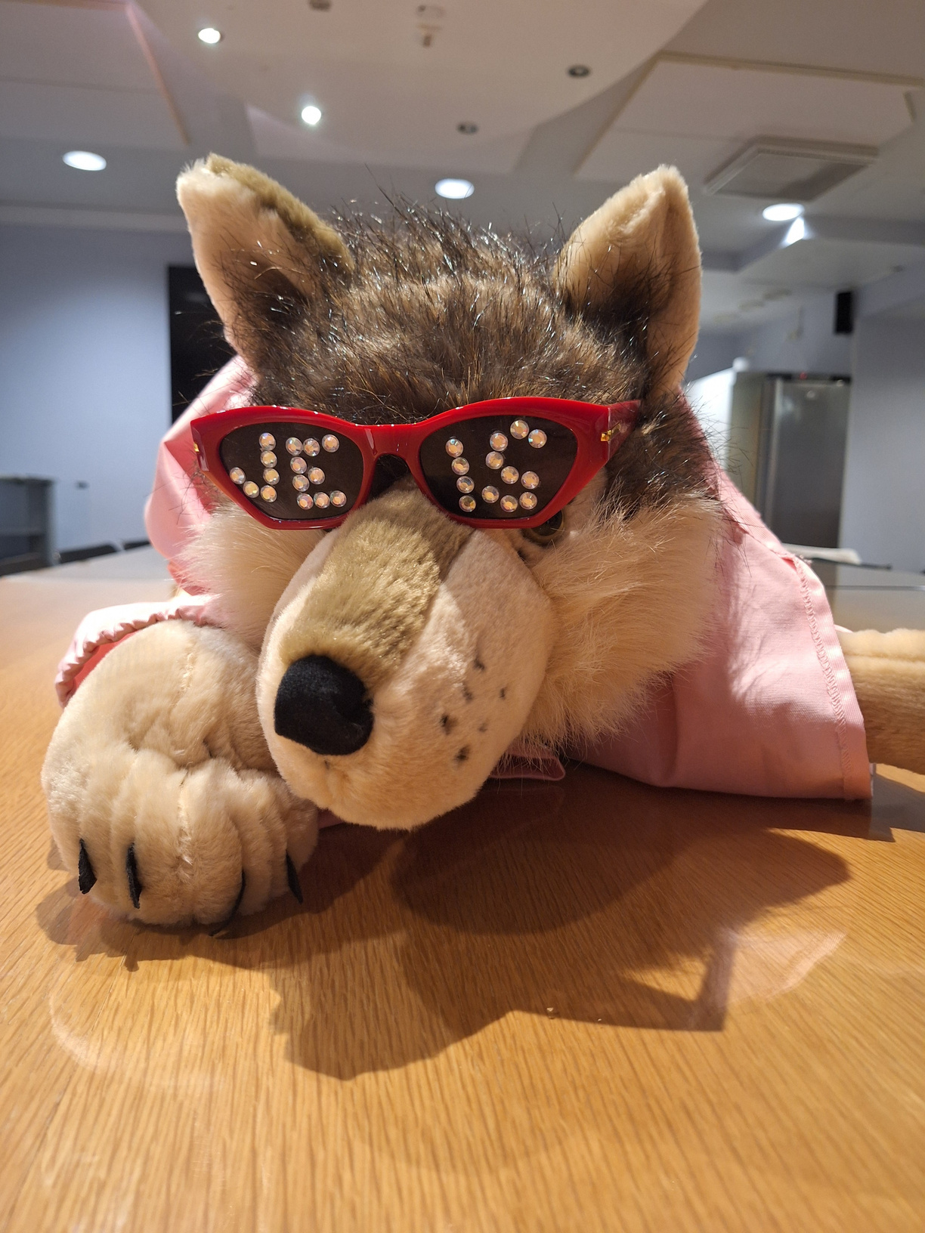


JEIS
Joensuu’s Exchange and International Students
Our mascot: Hukka
UEF orientation
Spring 2026
1

Slide 2
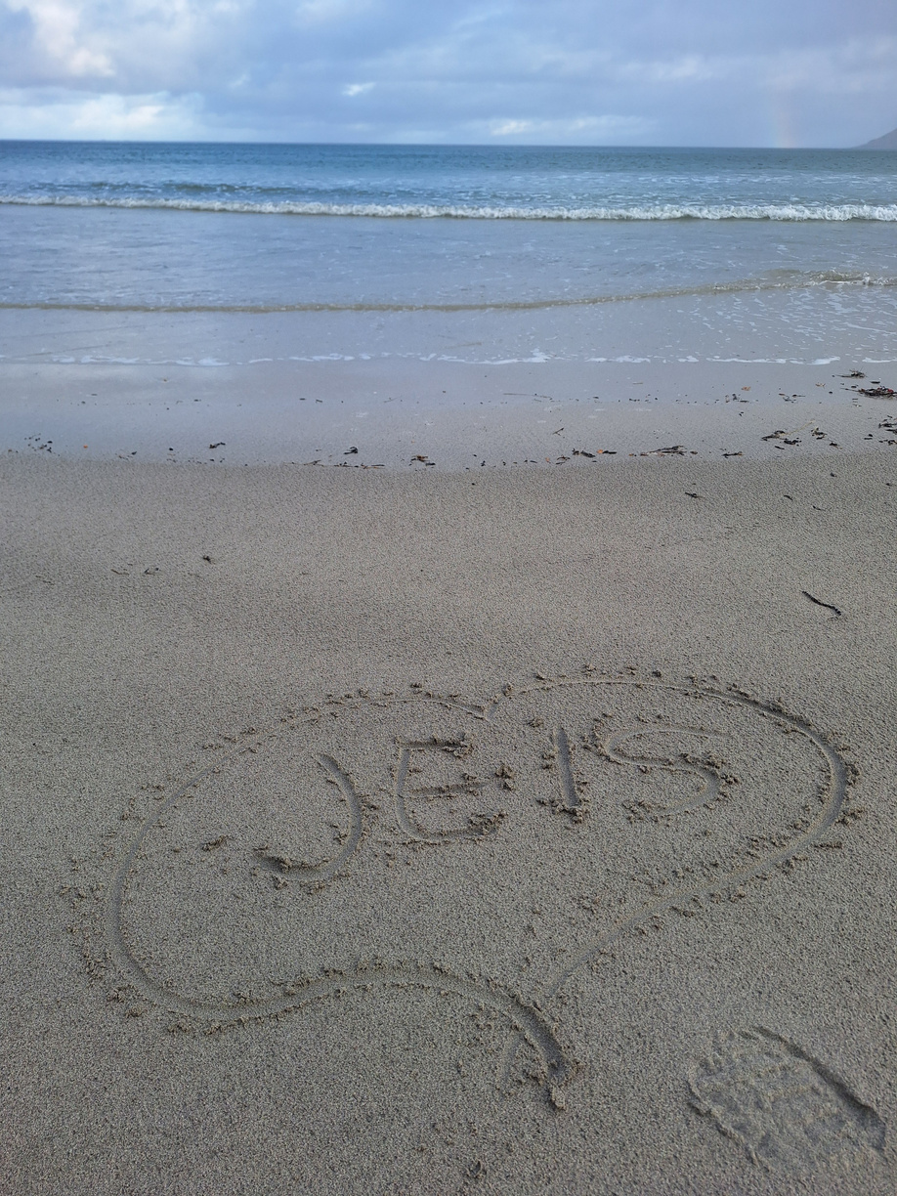
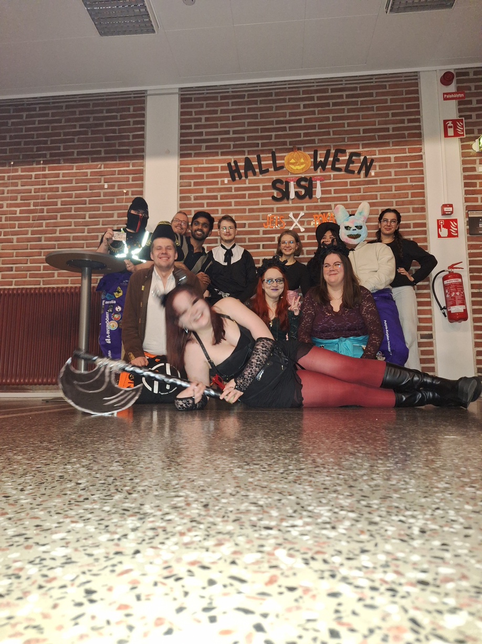
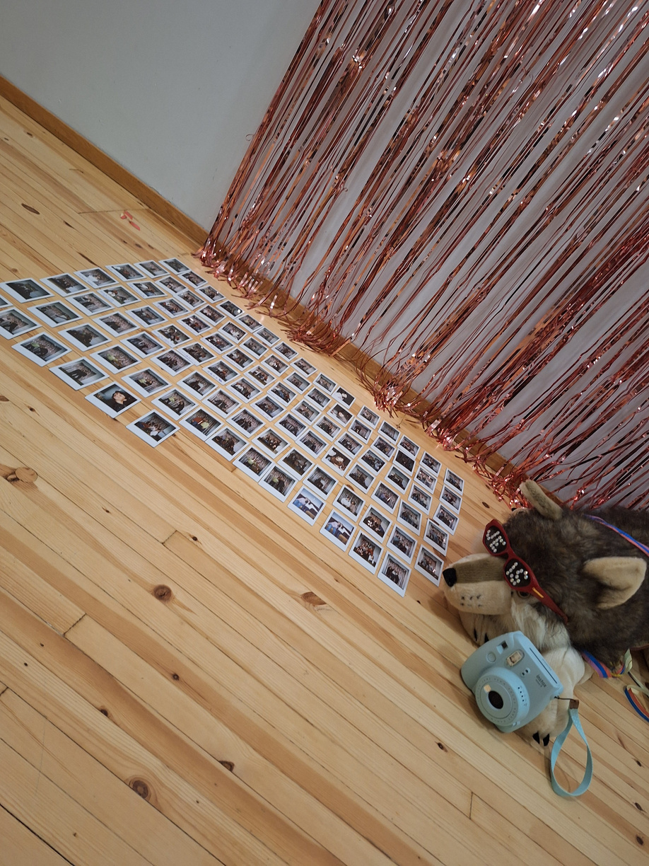
What is JEIS?
JEIS = Joensuu’s Exchange and
International Students
International club of ISYY (Student Union of the University of Eastern Finland)
We organise lots of events, trips and activities both on and off UEF campus for all!
Both international and Finnish students are welcome!
JEIS x TimeTravels Lofoten trip
JEIS X POKA Halloween sitsit
JEIS Farewell Party

Slide 3


Upcoming events this Spring
General meeting
13th of January 4.30pm - 6pm at AU102
Time Travel's trip dates
Saariselkä: 4.3.-9.3.2026
Lofoten: 23.4-30.4.2026
Participation requires JEIS membership
And lots of more in coming once we have new board! !
3

Slide 4
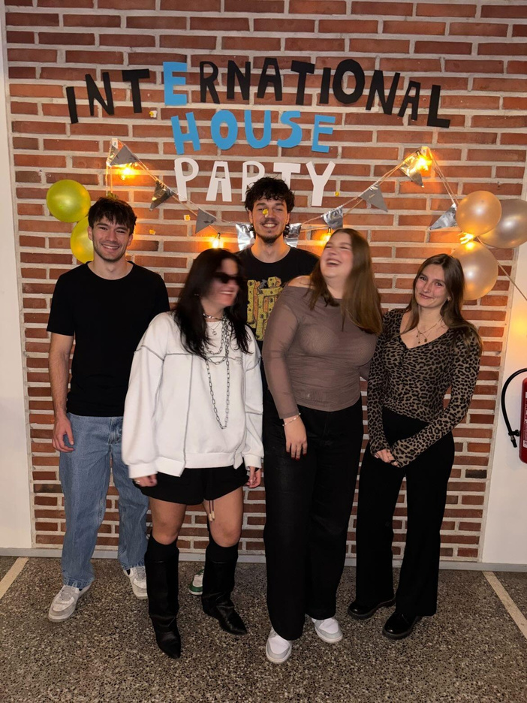

Why should I join JEIS and how I can I join JEIS?
JEIS events are for students in Joensuu. Most of our events are free for our members, and for some events, members get a discount!
JEIS is ISYY club so by joining ISYY, the student union of UEF you are already our member!
Here’s our members enjoying International House Party!
4

Slide 5
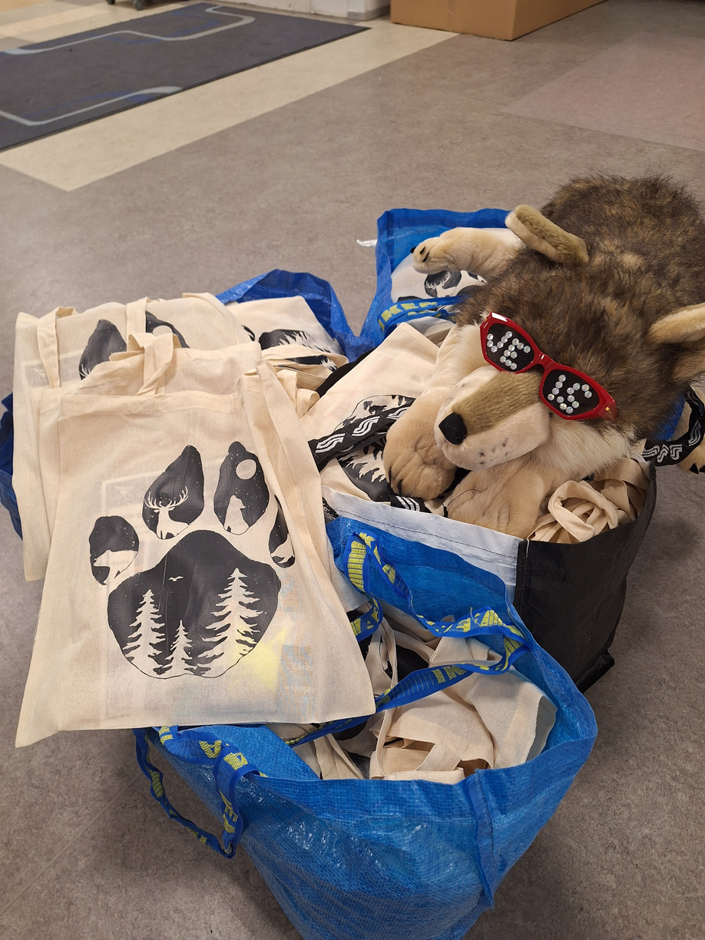
Welcome Bags
Welcome Bags are tote bags with some free goodies inside, such as:
ISYY student planner
Discount coupons to local bars, cafés, movie theater & restaurants
Reflectors
Elisa Prepaid-SIM Card
Coupons for free entry to nightclubs… etc.
FREE for all new JEIS members! *
2€ for non-ISYY/JEIS members
or old members *
* while the stock lasts
5

Slide 6

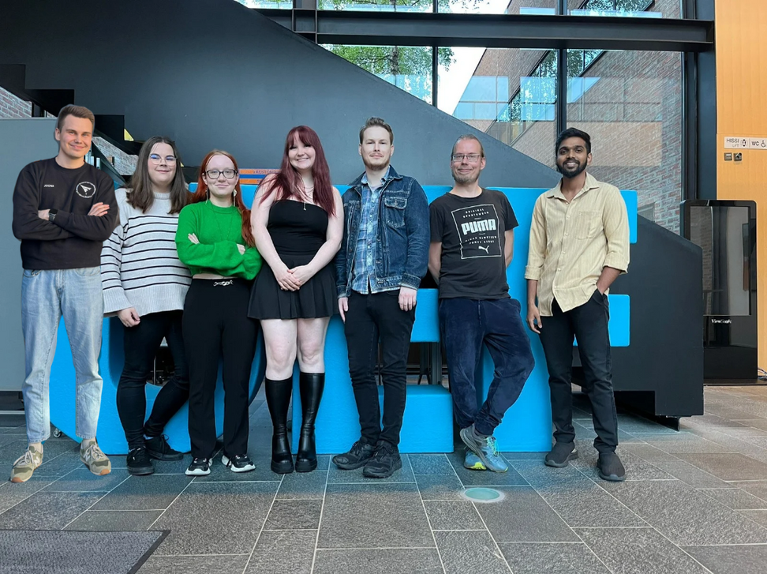

Want to be more than a member?
Do you want to be a part of making all of our events come to life? Join as an active member or apply to become a board member!
There are three different levels on being a member of JEIS:
JEIS Board Members – the people responsible for events and trips
JEIS Active Members - Come to our weekly meetings to share ideas and help plan and organise events
JEIS Members - Come to our events and enjoy!
The general meeting will be on January 13th in AU102 from 4.30 pm to 6 pm
JEIS Autumn 2025 board
6

Slide 7
Board positions
President (leader of the gang)*
Vice-president (left hand of the President, the bearer of good [and bad] news)*
Treasurer, Secretary & Trip Coordinator (money, money, money... paperwork paperwork, paperwork... trips, trips, trips...)**
1-2 Event Managers (the masterminds who organize our events)
1-2 Communication Managers (takes care of social media and communicates in Instagram DMs)
Graphic Designer and Photographer (creates flyers, is the visionary behind everything, takes/collects photos, catches us in our most photogenic faces (usually untrue))
Inventory Manager (Manages everything we have in our storage and updates the inventory Excel sheet)
*Has to be ISYY member
** Has to be ISYY employee
7

Slide 8

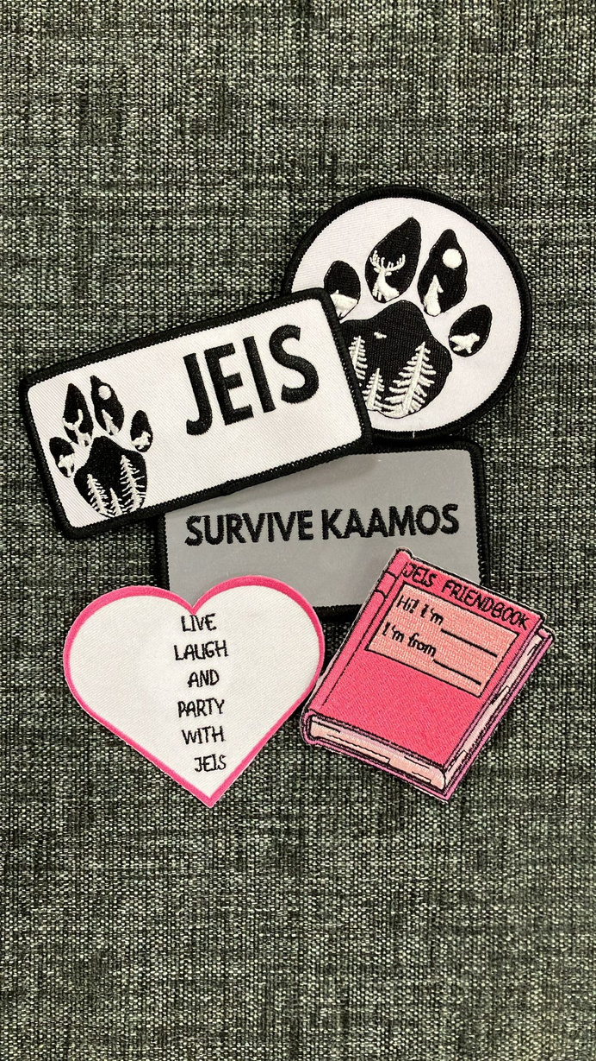
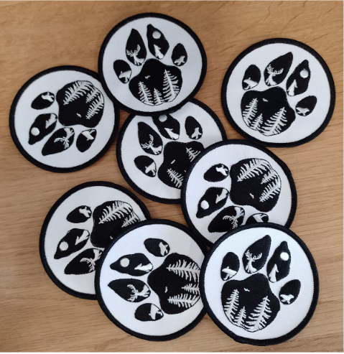
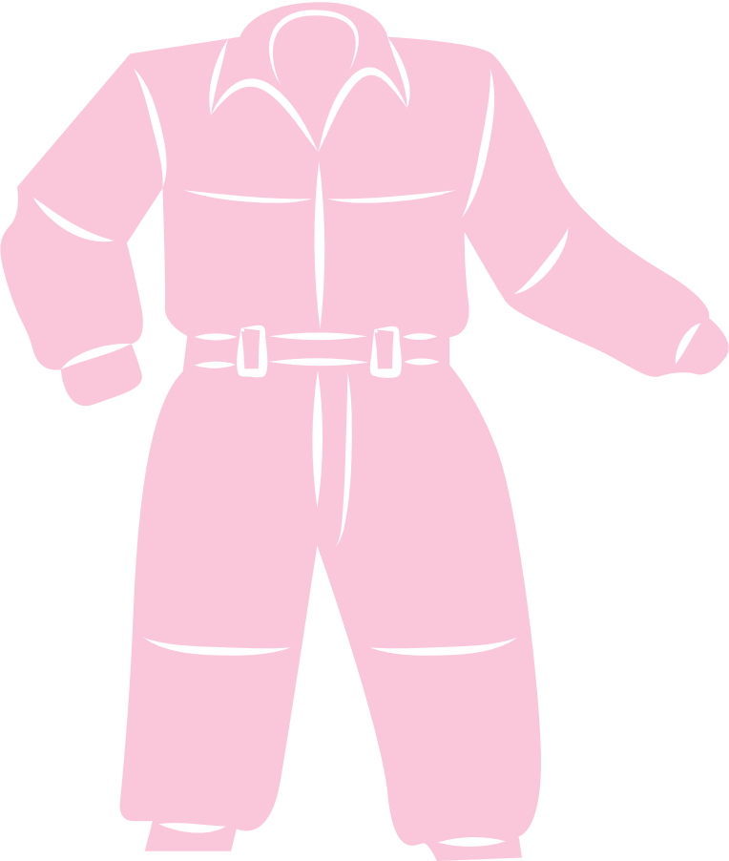
JEIS MERCH
You can buy JEIS merch from ISYY office!
JEIS logo badge 3€
There is very limited supply of JEIS overalls! More info coming on instagram about them!
JEIS patches
More merch is available at ISYY office!
(Suvantokatu 6, near K-Citymarket)
JEIS logo overall badge
8

Slide 9
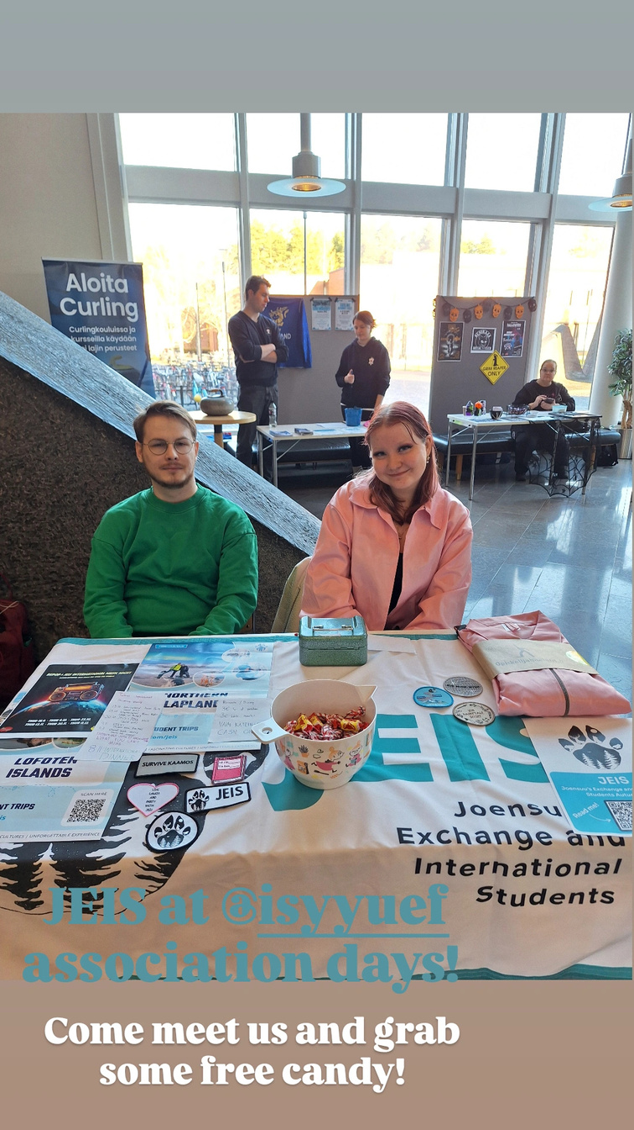




Follow us on social media!
All events will be announced in our socials and ISYY’s Weekly Feed newsletter!
@jeis_isyy
jeis@isyy.fi
If you have questions, just send us an email or DM us on Instagram
JEIS Team
isyy.fi/en – What’s On - Newsletter
9

Slide 10

Thank you for your attention!
Any questions?
10

