Slide 1
Official Matters
Orientation for International Students, Spring Semester 2026
Kirsi Konttinen

Slide 2
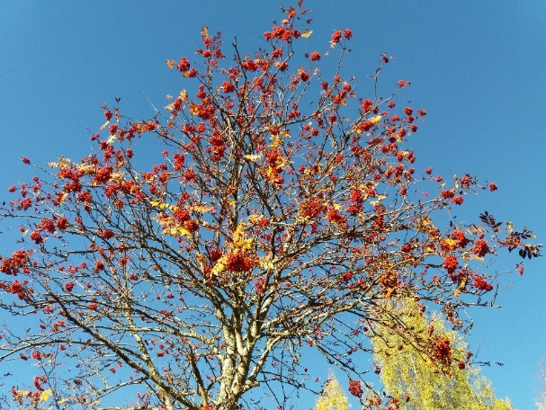
Topics
Registration as a Student at UEF
Student Cards
Right of Residence
Residence Permit
Registering the Right of Residence (EU citizens)
Registration at the local DVV Office (Digital and Population Data Services Agency)
Finnish Personal Identity Code (henkilötunnus), Notification of Move, Municipality of Residence (kotikuntaoikeus)
Health Care
Working
Driving
Banking
Phones
Recycling

Slide 3
Registration as a Student at UEF https://kamu.uef.fi/en/tietopankki/registration-instructions-for-new-students/registration-for-new-students/
The very first thing to take care of. (Students from outside EU should have a residence permit first.)
Fill out the form online (a separate form for the exchange students and for the degree seeking students)
After submitting the form the staff at the Student Services will process the information and you will receive the Study Certificate by email after this has been done.
After receiving the Study Certificate you will have an official student status at UEF and you can activate your UEF username.
The Study Certificate or a student card proves your student status and is needed in all official matters.
2.1.2026
3
Notes:
3

Slide 4
Student Cards
Frank.fi and Slice.fi https://www.isyy.fi/en/services/membership/student-card-and-term-sticker.html
The Student Union membership is required
Frank App or Slice.fi App
Study right number at UEF is needed
Tuudo.fi https://kamu.uef.fi/en/tools/download-tuudo-the-mobile-app-for-students/
Available for all students
Mobile app
Register with your UEF username and password
Automatic timetable generator for the courses you have registered
Digital library card
Campus maps
Menus of campus restaurants
2.1.2026
4
Notes:
4

Slide 5
Right of Residence
https://migri.fi/en/studying-in-finland
Your citizenship and the length of your stay determine what you should do.
Your citizenship
the Nordic countries (Sweden, Norway, Denmark, Iceland, Faroe Islands, Greenland)
EU member states, Liechtenstein and Switzerland
other countries (non-EU)
Length of your stay in Finland
3 months or less
3-12 months
Longer than a year
5
Notes:
5

Slide 6
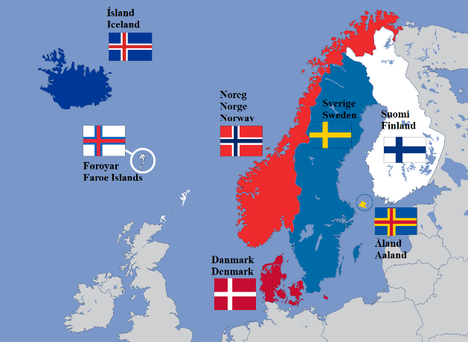
Right of Residence - Nordic citizens Notification of Move
Inform the DVV Office (Digital and Population Data Services Agency) about your move within a week https://dvv.fi/en/international-%20student
Nordic citizens are registered in the population register of only one country at a time.
Forms are available online.
To register you will need
identification (passport, ID card issued by the police or other corresponding document) – driving license is not accepted
study certificate
No need for the EU citizen’s registration of the right of residence.
6
Notes:
6

Slide 7

Right of Residence – EU citizens Registration of the Right of Residence
Registration of right of residence | Maahanmuuttovirasto
No residence permit required from the students from the EU member states, Liechtenstein and Switzerland.
If you stay longer than 3 months, register your right of residence at the Immigration Service (Migri)
The closest is in Kuopio, Address: Ajurinkatu 45
Make an appointment online:
https://migri.fi/en/service-points
Open Mon, Tue, Wed and Fri 8-16.15, Closed on Thu
The registration should be done within 3 months.
If you travel outside the Finnish borders, the period of 3 months will start over again!
For EU citizens staying in Finland for more than a year: registering the right of residence in Migri is required before you can have the permanent status in Finland (in DVV)
7
Notes:
7

Slide 8
Documents You Need
Identification: https://migri.fi/en/identification
Registration application (on-line or paper) or with on-line banking the application is on-line: https://enterfinland.fi/eServices/info/europeancitizens
A valid identity card or passport
The Study Certificate
A proof of your funds or a scholarship to cover your living expences in Finland
For example a document from your home university stating your exchange period and the scholarship you have received
Or another proof of how you are going to finance your stay in Finland (for example a letter from your parents)
Fee is 53 €.
https://migri.fi/en/registration-of-right-of-residence
8
Notes:
8

Slide 9
Right of Residence – Non-EU Citizens Residence Permit
Residence permit is required before entering Finland.
Usually valid for the study period or for a year.
Apply for extension about 3 months before your permit expires. If you plan to travel outside Finland, take this into consideration.
Renewing your residence permit at the Immigration Service, Migri Extended permit for studies | Maahanmuuttovirasto
Fill in the application on-line
Closest Migri is in Kuopio, address: Ajurinkatu 45
Make an appointment online:
https://migri.fi/en/service-points Open Mon, Tue, Wed and Fri 8-16.15, Closed on Thu
9
Notes:
9

Slide 10
Right of Residence – Non-EU Citizens
https://migri.fi/en/application-for-an-extended-permit-on-the-basis-of-studies
Documents required for extending the residence permit
a valid passport and colour copy of your passport
a proof of sufficient financial means (800€/month, for a family: Student’s family members | Maahanmuuttovirasto)
a proof of the tuition payment or a proof of a scholarship
a proof of health insurance
a study certificate (proving that you are a student)
transcript of records (proof of the progress of your studies)
a photograph Passport photograph instructions
Fees for extended permit: 180 € for electronic application and 280 € for paper application
2.1.2026
10
Notes:
10

Slide 11
Digital and Population Data Services Agency = DVV for Finnish Personal Identity Code
All international students need the Finnish personal identity code –you can get it from the DVV Office
The personal identy code is always used in official matters in Finland.
The personal identity code = your date of birth and four digits or three digits and a letter in a certain form (for example 010199-123B, 010100A1234)
Inform the UEF Student Services (email: opintorekisteri@uef.fi) about it as soon as you have it either by visiting the office and showing it or sending an email saying that you have it and what to do next. Use your UEF email when sending the code by email.
The students with a residence permit may already have the Finnish personal identity code on their residence permits. Please check. If you have it, inform the UEF Student Services.
2.1.2026
11
Notes:
11

Slide 12
Digital and Population Data Services Agency for Finnish Personal Identity Code for Notification of Move for Municipality or Residence
The basic data on foreigners are entered in the population information system
Name, date of birth, nationality, familial relationships and address
Notification of Move will be done at the same. Your postal address in Joensuu/Kuopio is registered.
Non-European degree students who stay in Finland for at least a year should register at the DVV Office for the municipality of residence (kotikuntaoikeus) even if they have the personal identity code already => the possibility to use Finnish public health care
2.1.2026
12
Notes:
12

Slide 13
Documents for registration in the Digital and Population Data Services Agency
1. Fill out the online form.
Fill in the online registration form on the DVV website: https://dvv.fi/en/international-student
Registration of a foreigner | Digital and population data services agency 2. Follow the instructions you have received from the DVV Office by email.
3. Visit the DVV office and bring along the required documents. These documents are required
Your passport or ID
Your study certificate
Your residence permit/EU citizen’s registration of the right of residence if you have one
13
Notes:
13

Slide 14
Documents for registration in the Digital and Population Data Services Agency
In Joensuu
You can visit the DVV Office at 9.00-15.30 without making an appointment on Thursdays 8 Jan, 15 Jan, and 12 Feb.
If you miss these, you can visit the office at 9-12 on Wednesdays without an appointment.
Or you can book an appointment online: https://secure.vihta.com/public-ng/dvv/#/home
Address: Kauppakatu 40 (city centre), https://dvv.fi/en/joensuu-en
14
Notes:
14

Slide 15
Documents for registration in the Digital and Population Data Services Agency
In Kuopio
You can visit the DVV office at 9-15 on Tue 13 Jan without making an appointment.
If you miss this date, you can visit the office at 9-12 on Wednesdays without an appointment.
Or you can book an appointment online: https://secure.vihta.com/public-ng/dvv/#/home
Address: Kallanranta 11 (city centre, close to the lake) https://dvv.fi/en/kuopio-en
15
Notes:
15

Slide 16
Health Care in Finland Health Care for Students - UEF Kamu
Finnish Student Health Services- Health care for students
Only for the degree seeking (Master’s and Bachelor’s) students.
NOTE: the fee for Student Health Care to be paid by the non-EU students: https://www.kela.fi/web/en/healthcare-fee-for-students-in-higher-education (For the EU students this is paid by their home countries.)
Exchange students and PhD students are not entitled.
Not for emergencies
Public health care
General public health care
Weekends, nights and emergencies
Private health care (Occupational health care)
accessible
expensive
2.1.2026
16
Notes:
16

Slide 17
Public Health Care – Who Is Entitled to Use?
Citizens of EU and EEA member states
European Health Insurance Card (EHIC)
not totally free, same fee as for Finns
Non-EU citizens
must have an insurance: Insurance | Maahanmuuttovirasto
entitled to emergency health care ONLY and full costs must be paid
Medical treatment is expensive.
If you have the municipality of residence (kotikuntaoikeus) and a permanent address in Finland (staying in Finland for the minimum of one year), you are entitled to the same health care benefits as Finns.
Citizens from the countries with a social security agreement with Finland
Nordic countries, the United States, Canada, Chile, Israel, Australia, India, China, South Korea, and Japan: International legislation | About Kela | Kela
17
Notes:
17

Slide 18

Public Health Care in Joensuu
Frontpage - Siun sote Appointment with a doctor or a nurse - Siun sote (The website seems to be partly in Finnish only. Maybe you can use a translation tool.)
General health care
To make an appointment, call the health station you want to visit Mon-Fri at 8.00-16.00
Health stations in Joensuu: Siilainen (address Noljakantie 17 a C, closest to campus), Niinivaara (Tikkamäentie 16, M-talo/M Building, 2nd floor, next to the hospital), Rantakylä (Ruoritie 3)
Never free of charge
Appointment fees for EU citizens and those who have municipality of residence in Joensuu:
GP approx. 29 €
GP appointments in evenings and on weekend 67 €
Specialist doctor approx. 67 € (only by GP’s referral)
Unused, not cancelled appointment about 57 €
2.1.2026
18
Notes:
18

Slide 19
Public Health Care in Joensuu
Evenings and weekends Central Hospital
Mon-Thu at 4-10 pm, Fri 3-10 pm
Weekends and public holidays 8 am – 10 pm
Call the Medical Helpline at +358 (0)17 116 117 beforehand
At night, in accidents and emergencies Emergency care - Siun sote
If possible, call the Medical Helpline at +358 (0)17 116 117 beforehand
Central Hospital (päivystys, on-call), address: Tikkamäentie 16, building J2
Only for emergencies: if it is not an emergency, contact the health care next morning
2.1.2026
19
Notes:
19

Slide 20
Public Health Care in Kuopio
https://pshyvinvointialue.fi/web/en (The website is partly in Finnish. Maybe you can use a translation tool.)
General health care Appointment with a Doctor or a Nurse - PSHVA - English - Pohjois-Savo (If in Finnish, use a translation tool)
Main Health Centre, address: Tulliportinkatu 15 H
Doctors are appointed to patients according to their address
To make an appointment, in urgent cases call the team nurse at 8-16 on Mon-Thu, at 8-15.30 on Fri. In non-urgent cases call at 8-10.
Never free of charge
Appointment fees for EU citizens and those who have municipality of residence in Kuopio:
GP 28,20 € (nighttime and weekends 38,70 €)
Specialist doctor approx. 66,70 € (only by GP’s referral)
Unused, not cancelled appointment about 57 €
2.1.2026
20
Notes:
20

Slide 21
Public Health Care in Kuopio
https://pshyvinvointialue.fi/web/en/emergency-care
Evenings and weekends (KYS Hospital)
Mon-Thu at 4-10 pm, Fri 3-10 pm
Weekends and public holidays 8 am – 10 pm
Call the health care service at +358 (0)17 116 117 beforehand
At night, in accidents and emergencies
If possible, call the health care service at +358 (0)17 116 117 beforehand
Kuopio University Hospital (KYS – päivystys, on-call), address: Puijonlaaksontie 2
Only for emergencies: if it is not an emergency, contact the health care next morning
2.1.2026
21
Notes:
21

Slide 22
General emergency number in Finland is 112
When to call 112?
In genuine emergency when urgent assistance from police, paramedics, or firefighters is needed.

Slide 23
Private Health Care in Joensuu and in Kuopio
Good choice if you have a private insurance to cover all the costs.
Be prepared to pay or make sure your insurance will cover the fees.
Private Health Care Clinics
For example
Mehiläinen www. mehilainen.fi
Pihlajalinna ITE https://www.pihlajalinna.fi/
Suomen Terveystalo www.terveystalo.com
2.1.2026
23
Notes:
23

Slide 24

Pharmacies
Medicine is sold only in pharmacies.
Medication with prescription and without
Electronic prescriptions
Opening hours
Mon – Fri 8:00/10:00 – 18:00/19:00
Sat 8:30/9:00 - 14:00/15:00
Yliopiston apteekki (University Pharmacy)
In Joensuu: Koskikatu 7, right by the marketplace (tori)
In Kuopio: Puijonkatu 23, right by the marketplace (tori)
Open daily 8:00-23:00
In Kuopio the closest pharmacies to campus are in Prisma and at the University Hospital KYS
2.1.2026
24
Notes:
24

Slide 25
Working in Finland
Finding a job, even a part-time job, is not easy for a foreigner!
Finnish skills are often required, at least some Finnish. The more you know the better!
Useful links:
Ohjaamo = support in looking for employment and help with career paths, a service for young people under 30 in the city centre: Front page - Ohjaamo Kuopio – Ohjaamo Ohjaamo 16–29-vuotiaille - joensuu.fi
www.mol.fi → Job Market, Finland
https://www.jobteaser.com/en
Work permit?
Student from EU/EEA + Switzerland: no permit needed, no limitations for working
Non-EU students: 30 hours/week on average and fulltime during holidays. No restrictions for work which is included in your degree (training or thesis): https://migri.fi/en/studying-in-finland
2.1.2026
25
Notes:
25

Slide 26

Taxation https://www.vero.fi/en/individuals/
If you work, you need to pay tax (vero) in Finland.
You need the Finnish Personal Identity Code for the tax card and you need a tax card in order to work here.
Contact the Tax Office (verotoimisto) to get the tax card and give it to your employer so that they can deduct the tax from your salary.
If you don’t have the tax card, 60% taxes will be deducted from your salary.
Your nationality, length of stay in Finland, etc. determine your tax rate. Finland has tax treaties with many countries.
If you work in Finland, please contact the Tax Office.
2.1.2026
26
Notes:
26

Slide 27
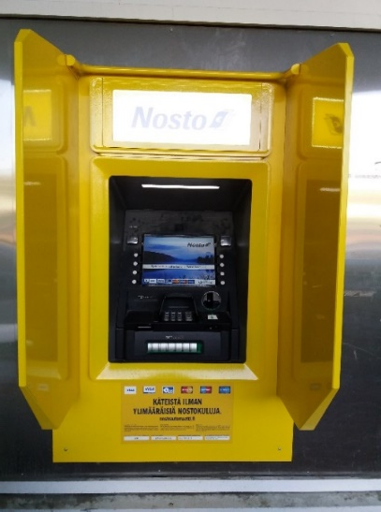

Banking
If you come from a SEPA (Single European Payments Area), not necessary to open a bank account in Finland (IBAN/BIC/SWIFT codes work) – use on-line banking
Paying bills in cash is difficult.
Banks are open from 9:30/10:00 to 16:00/16:30
Cash points: in Kuopio nearest in Prisma Supermarket; in Joensuu in the city center
Finnish banks for example:
Nordea, Osuuspankki, Danske Bank, S-pankki, Säästöpankki
Opening a bank account in Finland is a lengthy process.
Online banks for example:
N26, Revolut, Wise (former TransferWise)
2.1.2026
27
Notes:
27

Slide 28
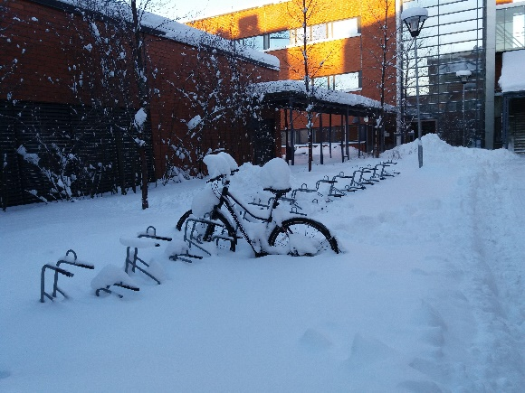
Good to Know about Cycling
Cyclists must keep to cycle tracks whenever possible.
Keep to the right.
Use a white front light and a red rear light in the dark. There will be a fine if you don’t.
Reflectors on the bike are compulsory, too. Everybody should wear reflectors in the dark!
A proper helmet may look stupid but can save your life.
When joining a street from a cycle track, the cyclist must always give way to other traffic both from the left and from the right.
2.1.2026
28
Notes:
28

Slide 29

Driving in Finland
Are you allowed to drive in Finland?
A license from an EU/EEA country is valid
A license from a country that has signed the Geneva or Vienna convention countries is valid for two years after your arrival date. After that it is to be changed into a Finnish driving license.
For example Egypt, Ghana, India, Russia, Turkey, USA
Driving licenses from other countries are valid for one year after your information is entered into the Finnish population system (registration at the Digital and Population Data Services Agency)
https://www.infofinland.fi/en/information-about-finland/basic-information-about-finland/traffic-in-finland
2.1.2026
29
Notes:
29

Slide 30
Good to Know about Driving in Finland https://www.liikenneturva.fi/en/road-safety
Check the weather forecast and warnings before driving.
Driving in difficult conditions: Difficult driving conditions - Liikenneturva
The general speed limit in Finland is 30 or 40 km/h in built-up areas and 80 km/h outside.
Speed surveillance cameras are common.
Headlights and seatbelts must be used at all times.
Winter tires mandatory according to weather and road conditions
friction or studded tires
engine heaters in winter are recommended
2.1.2026
30
Notes:
30

Slide 31

Good to Know about Driving in Finland https://www.liikenneturva.fi/en/road-safety
Using phone when driving is not allowed! A hands-free device has to be used.
When driving at night/around dusk beware of elk or deer (or reindeer in the North)
Only drive when sober!
Immediate arrest if your blood alcohol level is over 0.5 ‰
If you own a car, make sure you have paid all the necessary insurance fees in Finland.
2.1.2026
31
Notes:
31

Slide 32

Mobile Phones
Phone subscriptions
Students from EU area: check the prices with your own operator
Two options in Finland
Pre-paid: a bit more expensive phone calls, no bills or fees, from R-kiosks
Subscription: a deposit or a sponsor is required, from mobile phone shops
Check out for the best deals
Mobile operators: Telia, Elisa, DNA
2.1.2026
32
Notes:
32

Slide 33
Recycling
Do not buy anything you do not really need!!
Reuse things.
2.1.2026
33
Notes:
33

Slide 34
Recycling
Different kind of waste goes into different containers.
Various containers by the rubbish shelter or at the recycling points (containers next to Prisma):
Biowaste = biojäte, no plastic bags!
Paper = paperi
Household cardboard and cartons = pahvi (cartons for milk and yogurt, biscuit boxes)
Hazardous waste (batteries, chemicals)
Glass = lasi
Tins and cans – metal = metalli
Plastic = muovi, dry and clean plastics (hard and soft plastic):
plastic packs and wrappings for goods and for food
Household waste (mixed)
2.1.2026
34
Notes:
34

Slide 35
Recycling
Bottles and cans (plastic, metal, glass) – return them in a machine and you will get money back!
Bottles from LIDL have their own system
Unused medicine should be taken to a pharmacy
2.1.2026
35
Notes:
35

Slide 36

Kiitos
uef.fi

